Slide 1



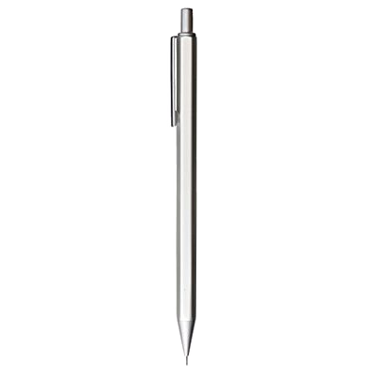
Housing Price
Prediction
Submitted By
Matta Akhil Reddy
Start

Slide 2
ACKNOWLEDGMENT
I would like to thank FlipRobo Technologies for providing me with this opportunity for writing the blog, and also in providing the guidance and constant support in providing necessary information regarding the project, by providing their support in completing the project.
I also want to thank my SME Ms.Khushboo garg for their instant response in solving the problems and providing the valuable information by addressing out our query in right time.

Slide 3
INTRODUCTION
Business Problem Framing:
Houses are one of the necessary need of each and every person around the globe and therefore housing and real estate market is one of the markets which is one of the major contributors in the world’s economy.
It is a very large market and there are various companies working in the domain. Data science comes as a very important tool to solve problems in the domain to help the companies increase their overall revenue, profits, improving their marketing strategies and focusing on changing trends in house sales and purchases. Predictive modelling, Market mix modelling, recommendation systems are some of the machine learning techniques used for achieving the business goals for housing companies.
Our problem is related to one such housing company. A US-based housing company named Surprise Housing has decided to enter the Australian market. The company uses
data analytics to purchase houses at a price below their actual values and flip them at a higher price. For the same purpose, the company has collected a data set from the sale of houses in Australia.
The company is looking at prospective properties to buy houses to enter the market.

Slide 4
Business Goal
You are required to model the price of houses with the available independent variables. This model will then be used by the management to understand how exactly the prices vary with the variables. They can accordingly manipulate the strategy of the firm and concentrate on areas that will yield high returns. Further, the model will be a good way for the management to understand the pricing dynamics of a new market.
We will have two types of data,
Training Data - This data will contain the information related to the Year Sold and Sale Price of House.
Test Data - It will contain all the information about a house. And, based on all the given information, Logistic Regression Algorithm will predict the selling price of a house.

Slide 5
Conceptual Background
of the Domain problem
Predictive modelling, Market mix modelling, recommendation systems are some of the machine learning techniques used for achieving the business goals for housing companies.
Hedonic Characteristics of Housing Price: A Hedonic approach is preferred for predicting the sale prices in the housing market because the market displays resilience, flexibility and spatial fixity.
Housing Attributes: Studying the structural, locational, and economic attributes of housing properties is crucial in understanding their mutually inclusive relationships with their pricing

Slide 6
Motivation of the problem Undertaken
There is a steady rise in house demand with every passing year, and consequently the house prices are rising every year. The problem arises when there are numerous variables such as location and property demand that influence the pricing. Therefore, buyers, sellers, developers and the real estate industry are keen to know the most important factors influencing the house price to help investors make sound decisions and help house builders set the optimal house price.
There are many benefits that home buyers, property investors, and house builders can reap from the house-price model. This model aims to serve as a repository of such information and gainful insights to home buyers, property investors and house builders, that will help them determine best house prices.
This model can be useful for potential buyers in deciding the characteristics of a house they want that best fits their budget and will be of tremendous benefit, especially to housing developers and researchers, to ascertain the most significant attributes to determine house prices and to acknowledge the best machine learning model to be used to conduct a study in this field.

Slide 7
Motivation of the problem Undertaken
There is a steady rise in house demand with every passing year, and consequently the house prices are rising every year. The problem arises when there are numerous variables such as location and property demand that influence the pricing. Therefore, buyers, sellers, developers and the real estate industry are keen to know the most important factors influencing the house price to help investors make sound decisions and help house builders set the optimal house price.
There are many benefits that home buyers, property investors, and house builders can reap from the house-price model. This model aims to serve as a repository of such information and gainful insights to home buyers, property investors and house builders, that will help them determine best house prices.
This model can be useful for potential buyers in deciding the characteristics of a house they want that best fits their budget and will be of tremendous benefit, especially to housing developers and researchers, to ascertain the most significant attributes to determine house prices and to acknowledge the best machine learning model to be used to conduct a study in this field.

Slide 8
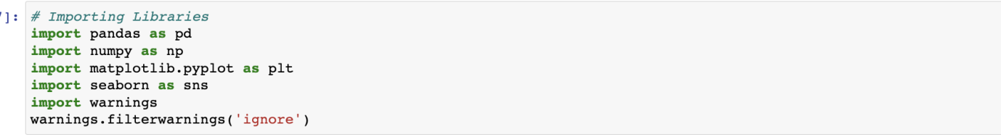
Importing Required Libraries
Imported the required Libraries in intial stage

Slide 9
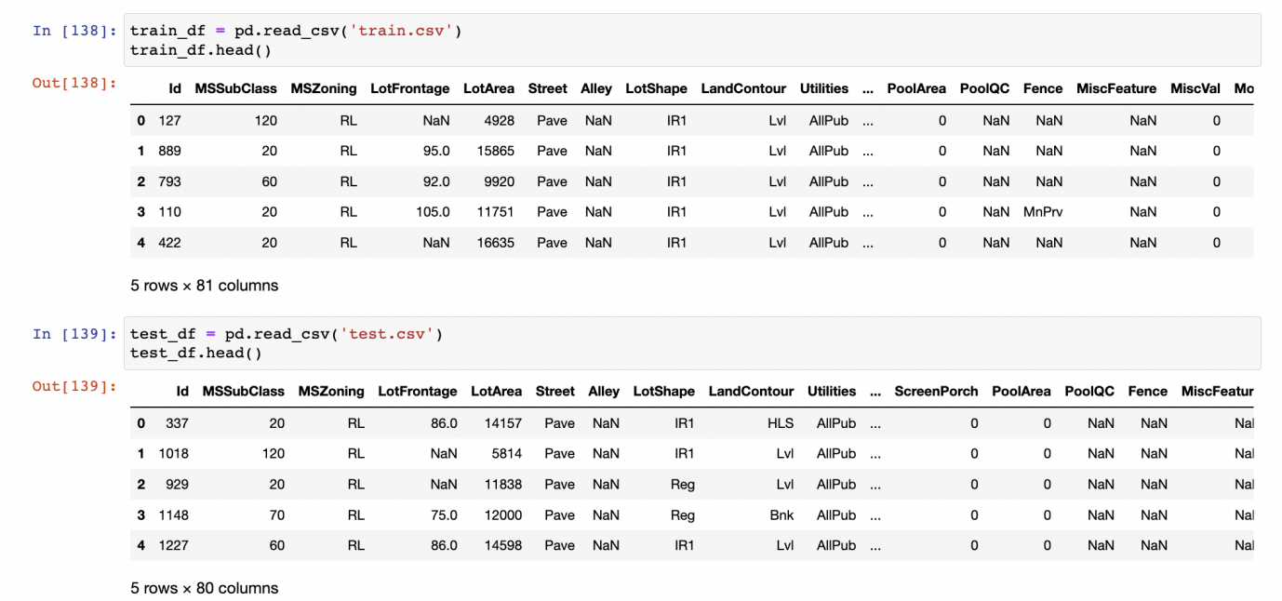
Train Data and Test Data
Below mentioned is the sample of Train Data and Test Data

Slide 10
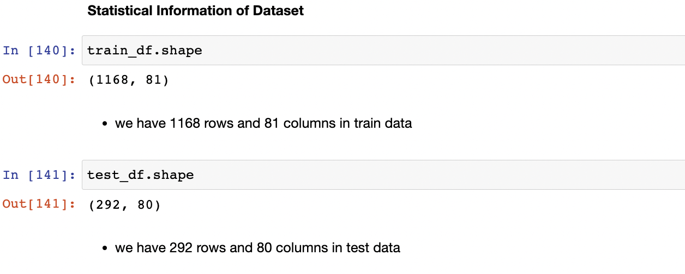
Shape of Train Data and Test Data
Below mentioned is the Shape of Train Data and Test Data

Slide 11
Information of the DataFrame
35 BsmtFinType2 1137 non-null object
36 BsmtFinSF2 1168 non-null int64
37 BsmtUnfSF 1168 non-null int64
38 TotalBsmtSF 1168 non-null int64
39 Heating 1168 non-null object
40 HeatingQC 1168 non-null object
41 CentralAir 1168 non-null object
42 Electrical 1168 non-null object
43 1stFlrSF 1168 non-null int64
44 2ndFlrSF 1168 non-null int64
45 LowQualFinSF 1168 non-null int64
46 GrLivArea 1168 non-null int64
47 BsmtFullBath 1168 non-null int64
48 BsmtHalfBath 1168 non-null int64
49 FullBath 1168 non-null int64
50 HalfBath 1168 non-null int64
51 BedroomAbvGr 1168 non-null int64
52 KitchenAbvGr 1168 non-null int64
53 KitchenQual 1168 non-null object
54 TotRmsAbvGrd 1168 non-null int64
55 Functional 1168 non-null object
56 Fireplaces 1168 non-null int64
57 FireplaceQu 617 non-null object
58 GarageType 1104 non-null object
59 GarageYrBlt 1104 non-null float64
60 GarageFinish 1104 non-null object
61 GarageCars 1168 non-null int64
62 GarageArea 1168 non-null int64
63 GarageQual 1104 non-null object
64 GarageCond 1104 non-null object
65 PavedDrive 1168 non-null object
66 WoodDeckSF 1168 non-null int64
67 OpenPorchSF 1168 non-null int64
68 EnclosedPorch 1168 non-null int64
69 3SsnPorch 1168 non-null int64
70 ScreenPorch 1168 non-null int64
71 PoolArea 1168 non-null int64
72 PoolQC 7 non-null object
73 Fence 237 non-null object
74 MiscFeature 44 non-null object
75 MiscVal 1168 non-null int64
76 MoSold 1168 non-null int64
77 YrSold 1168 non-null int64
78 SaleType 1168 non-null object
79 SaleCondition 1168 non-null object
80 SalePrice 1168 non-null int64
DataFrame Information
# Column Non-Null Count Dtype
--- ------ -------------- -----
0 Id 1168 non-null int64
1 MSSubClass 1168 non-null int64
2 MSZoning 1168 non-null object
3 LotFrontage 954 non-null float64
4 LotArea 1168 non-null int64
5 Street 1168 non-null object
6 Alley 77 non-null object
7 LotShape 1168 non-null object
8 LandContour 1168 non-null object
9 Utilities 1168 non-null object
10 LotConfig 1168 non-null object
11 LandSlope 1168 non-null object
12 Neighborhood 1168 non-null object
13 Condition1 1168 non-null object
14 Condition2 1168 non-null object
15 BldgType 1168 non-null object
16 HouseStyle 1168 non-null object
17 OverallQual 1168 non-null int64
18 OverallCond 1168 non-null int64
19 YearBuilt 1168 non-null int64
20 YearRemodAdd 1168 non-null int64
21 RoofStyle 1168 non-null object
22 RoofMatl 1168 non-null object
23 Exterior1st 1168 non-null object
24 Exterior2nd 1168 non-null object
25 MasVnrType 1161 non-null object
26 MasVnrArea 1161 non-null float64
27 ExterQual 1168 non-null object
28 ExterCond 1168 non-null object
29 Foundation 1168 non-null object
30 BsmtQual 1138 non-null object
31 BsmtCond 1138 non-null object
32 BsmtExposure 1137 non-null object
33 BsmtFinType1 1138 non-null object
34 BsmtFinSF1 1168 non-null int64

Slide 12
Features Description
Id : Unique id of the housing prediction dataset
MSSubClass : The Building class
MSZoning : zone of the house(RL, RM, FV, RH, C(all))
LotFrontage : Linear feet of street connected to property
LotArea : Lot size in square feet
Street : This talks about the type of road(Pave/gravel)
Alley : Type of alley access (pave,grvl) note: we have nan values in this feature
LotShape : general shape of the property('IR1', 'Reg', 'IR2', 'IR3')
LandContour : Flatness of the property ['Lvl', 'Bnk', 'HLS', 'Low']
Utilities : Type of utilities available['AllPub'], as we have only one variable we can drop
LotConfig : Lot configuration ['Inside', 'CulDSac', 'FR2', 'Corner', 'FR3']
LandSlope : Slope of property ['Gtl', 'Mod', 'Sev']
Neighborhood : Physical locations within ames city limits ['NPkVill', 'NAmes', 'NoRidge', 'NWAmes', 'Gilbert', 'Sawyer','Edwards', 'IDOTRR', 'CollgCr', 'Mitchel', 'Crawfor', 'BrDale','StoneBr', 'BrkSide', 'NridgHt', 'OldTown', 'Somerst', 'Timber','SWISU', 'SawyerW', 'ClearCr', 'Veenker', 'Blmngtn', 'MeadowV','Blueste']
Condition1 : Proximity to main road or rail road ['Norm', 'Feedr', 'RRAn', 'PosA', 'RRAe', 'Artery', 'PosN', 'RRNe','RRNn']
Condition2 : Proximity to main road or rail road if a second is present ['Norm', 'RRAe', 'Feedr', 'PosN', 'Artery', 'RRNn', 'PosA', 'RRAn']
BldgType : Type of dwelling ['TwnhsE', '1Fam', 'Duplex', 'Twnhs', '2fmCon']
HouseStyle : style of dwelling ['1Story', '2Story', '1.5Fin', 'SFoyer', '1.5Unf', 'SLvl', '2.5Fin','2.5Unf']
OverallQual : Overall quality [ 6, 8, 7, 5, 9, 1, 2, 4, 3, 10]
OverallCond : Overall Condition [5, 6, 7, 4, 8, 2, 3, 9, 1]
YearBuilt : Construction Date (min : 1875, max :2010)
YearRemodAdd : remodel date (max:2010,min 1950)
RoofStyle : Style of the roof ['Gable', 'Flat', 'Hip', 'Shed', 'Gambrel', 'Mansard']
RoofMatl : roof material ['CompShg', 'Tar&Grv', 'WdShngl', 'WdShake', 'Roll', 'ClyTile','Metal', 'Membran']
Exterior1st : Exterior covering of house ['Plywood', 'Wd Sdng', 'MetalSd', 'CemntBd', 'VinylSd', 'HdBoard','Stucco', 'WdShing', 'BrkFace', 'Stone', 'AsbShng', 'AsphShn','ImStucc', 'BrkComm']
Exterior2nd : Exterior covering of house if more than one material ['Plywood', 'Wd Sdng', 'MetalSd', 'CmentBd', 'VinylSd', 'HdBoard','Wd Shng', 'Stucco', 'ImStucc', 'Stone', 'BrkFace', 'AsbShng','Brk Cmn', 'AsphShn', 'Other']
MasVnrType : Masonry veneer type ['None', 'BrkFace', 'Stone', 'BrkCmn', nan] we have nan and None type values here
MasVnrArea : Masonry veneer area in square feet
ExterQual : Exterior material quality ['TA', 'Gd', 'Ex', 'Fa']
ExterCond : present condition of the material on the

Slide 13
Features Description
Foundation : Type of foundation ['CBlock', 'PConc', 'BrkTil', 'Slab', 'Stone', 'Wood']
BsmtQual : Height of the basement ['Gd', 'TA', 'Ex', nan, 'Fa'] we have NaN values
BsmtCond : General condition of the basement ['TA', 'Gd', 'Fa', nan, 'Po'] we have NaN values
BsmtExposure : walk out or garden level basement walls ['No', 'Gd', 'Av', 'Mn', nan] we have Nan values
BsmtFinType1 : quality of basement finished area ['ALQ', 'GLQ', 'BLQ', 'Unf', 'Rec', 'LwQ', nan]
BsmtFinSF1 : type 1 finished square feet.
BsmtFinType2 : quality of seconf finished area if present ['Unf', 'Rec', 'BLQ', 'GLQ', nan, 'ALQ', 'LwQ'] we have nan values
BsmtFinSF2 : Type 2 finished square feet
BsmtUnfSF : Unfinished squarefeet of basement area
TotalBsmtSF : Total sqaure feet of basement area
Heating : type of heating ['GasA', 'GasW', 'Floor', 'OthW', 'Wall', 'Grav']
HeatingQC : Heating quality and condition ['TA', 'Ex', 'Gd', 'Fa', 'Po']
CentralAir : Central Air condition
Electrical : electrical system ['SBrkr', 'FuseA', 'FuseF', 'FuseP', 'Mix']
1stFlrSF : first floor square feet
2ndFlrSF : second floor square feet
LowQualFinSF : low quality finished square feet all floors
GrLivArea : above grade living area square feet
BsmtFullBath : basement full bathrooms
BsmtHalfBath : basement half bathrooms
FullBath : full bath rooms above grade
HalfBath : Half baths above grade
BedroomAbvGr : no of bedrroms above basement level
KitchenAbvGr : no of kitchens
KitchenQual : Kitchen quality
TotRmsAbvGrd: Total rooms above grade (does not include bathrooms)
Functional: Home functionality rating
Fireplaces: Number of fireplaces
FireplaceQu: Fireplace quality
GarageType: Garage location
GarageYrBlt: Year garage was built
GarageFinish: Interior finish of the garage
GarageCars: Size of garage in car capacity
GarageArea: Size of garage in square feet
GarageQual: Garage quality
GarageCond: Garage condition

Slide 14
Features Description
PavedDrive: Paved driveway
WoodDeckSF: Wood deck area in square feet
OpenPorchSF: Open porch area in square feet
EnclosedPorch: Enclosed porch area in square feet
3SsnPorch: Three season porch area in square feet
ScreenPorch: Screen porch area in square feet
PoolArea: Pool area in square feet
PoolQC: Pool quality
Fence: Fence quality
MiscFeature: Miscellaneous feature not covered in other categories
MiscVal: Value of miscellaneous feature
MoSold: Month Sold
YrSold: Year Sold
SaleType: Type of sale
SaleCondition: Condition of sale

Slide 15
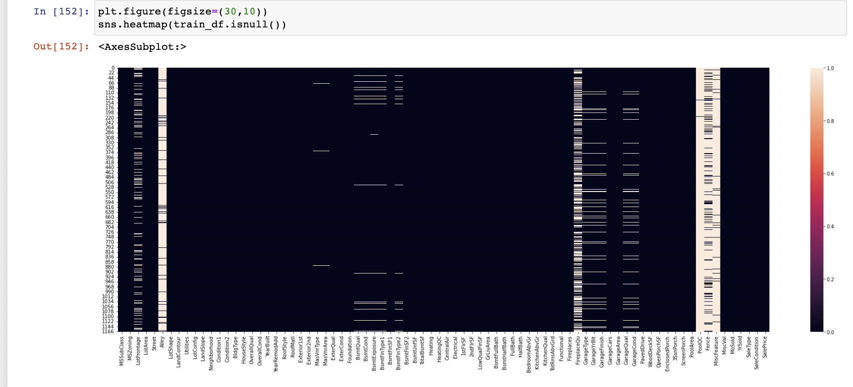
Data Preprocessing
Checking For the Null Values in the Dataset
we have Null values in
LotFrontage
Alley
MasVnrType
MasVnrArea
BsmtQual
BsmtCond
BsmtExposure
BsmtFinType1
BsmtFinType2
FireplaceQu
GarageType
GarageYrBlt
GarageFinish
GarageQual
GarageCond
PoolQC
Fence
MiscFeature

Slide 16
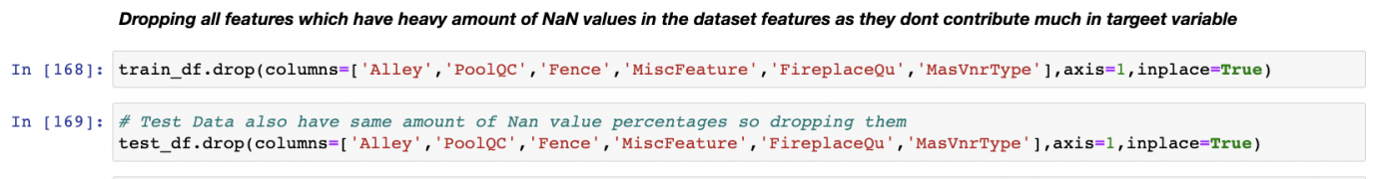
Dropping ID Column as it is Not Contributing For Model
The ID columns from test and train datasets were dropped
since they don't contribute to building a good model for predicting
the target variable values

Slide 17
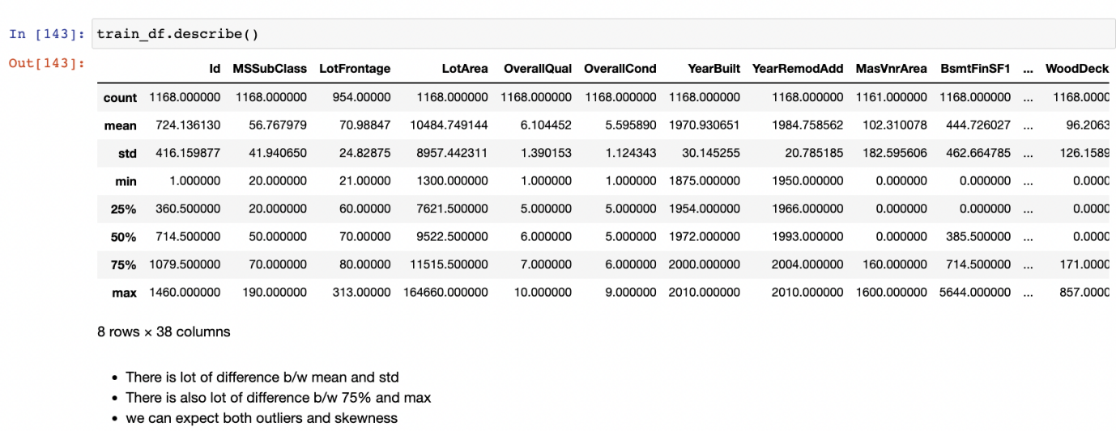
Statistical Information of the DataSet
Based on the above results i have observed.
Huge Difference b/w max value and 75% in SalePrice, MSSubClass,
LotFrontage,LotArea, BsmtFinSF1,BsmtFinSF2 etc which are
indicating presence of outliers.
There is the presence of higher standard deviation which
indicates the presence of skewness.

Slide 18

Hardware & Software used
Hardware and Software used for creation of Model
Hardware:
Processor Apple M1
Physical Memory: 8 GB
Softwares:
MAC operating system
Anaconda
Jupyter Notebook
Python
pandas
numpy
matplotlib
seaborn
scipy
statsmodels
sklearn

Slide 19
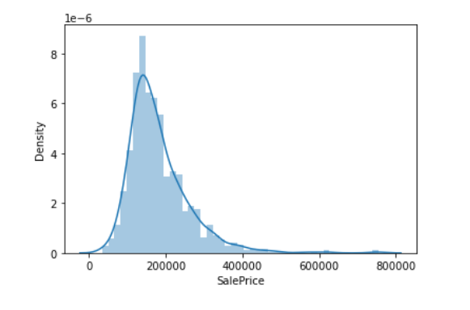
Exploratory Data Analysis
Graph for the Target Class

Slide 20
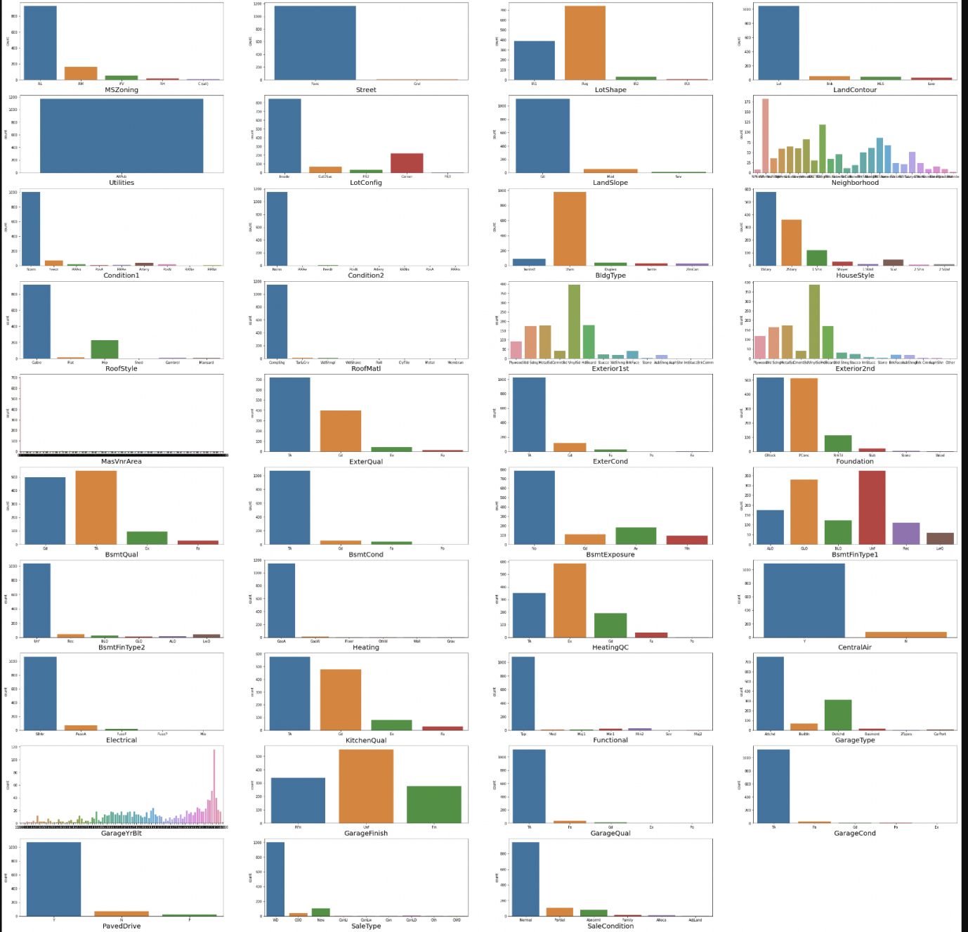
Univariate Analysis

Slide 21
Univariate Analysis
Observations
MSZoning has the more data related to RL
Most common street type isi pave
Most of the Lotshapes has the regular structures
Most of the properties has lv1
utilities has only one value(ALLPUB)
Most common LotConfig is Inside type
slope of property land is mostly gentle
Most of the properties are situated in neighborhoods of Neighborhoods of North AMerica,followed by college creek Edwards and old town
Most of the housing properties with feature condition1 and condition2 are in normal conditions
Mostly all the propertie sare 1 storey and 2 storey
Most of the properties with feature BldgtYPE HAS IFam type
Most of properties have the Gable type roofstyle
Most of the properties used roofMatl has Compshg
most of the properties has Exteriors has vinylsd type
most of properties dont have masonry veneer type while some has brick face
Most of the properties has the typical/average exteriors
Most of the properties has the typical/average exterior conditions
most of the properties has foundation type as cblock.pconc
The height of the basement is usually either typical (80-89 inches) or good (90-99 inches)
The general condition of the basement is commonly Typical with slight dampness
Basements most commonly have no exposure
Most of the houses basements are unfinished followed by houses with basements having good living quarters
most houses have gas forced warm air furnance heating arrangment
most properties have good good quality and condition
●
most properties have air conditioning
most properties have standarad circuit breakers and romex electrical system
most properties have good kitchen quality
most properties has garage attached to home
most of the properties has unfinished garage
garage condition is usually typical/average
conventional is most common type of sale

Slide 22
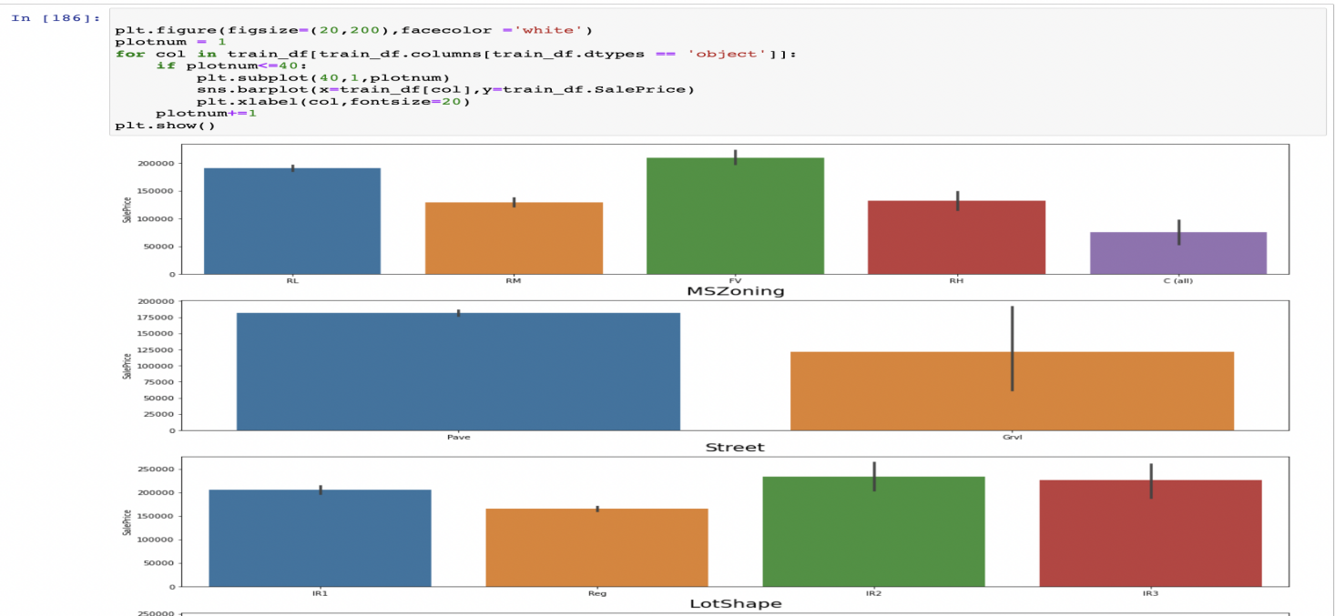
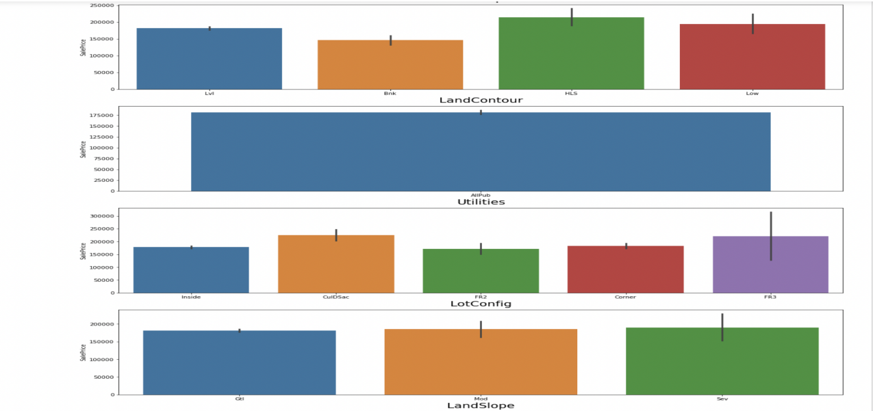
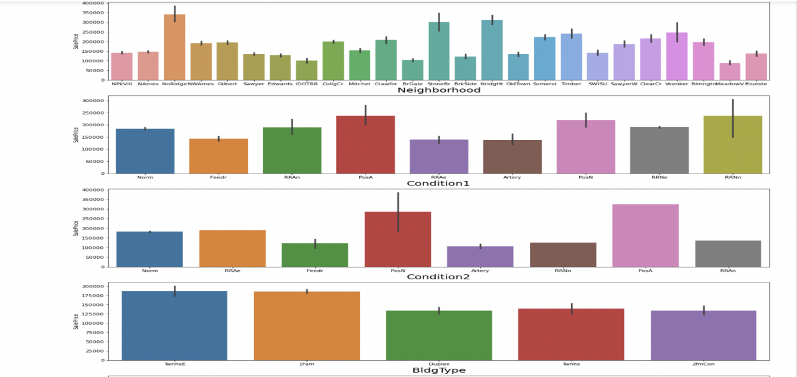
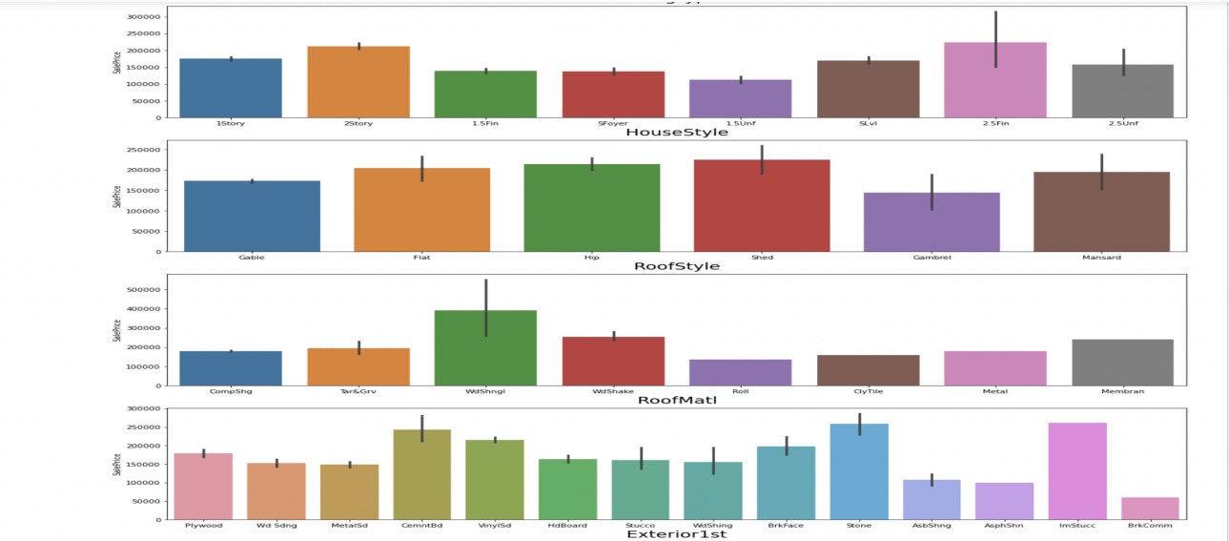
BiVariate Analysis

Slide 23
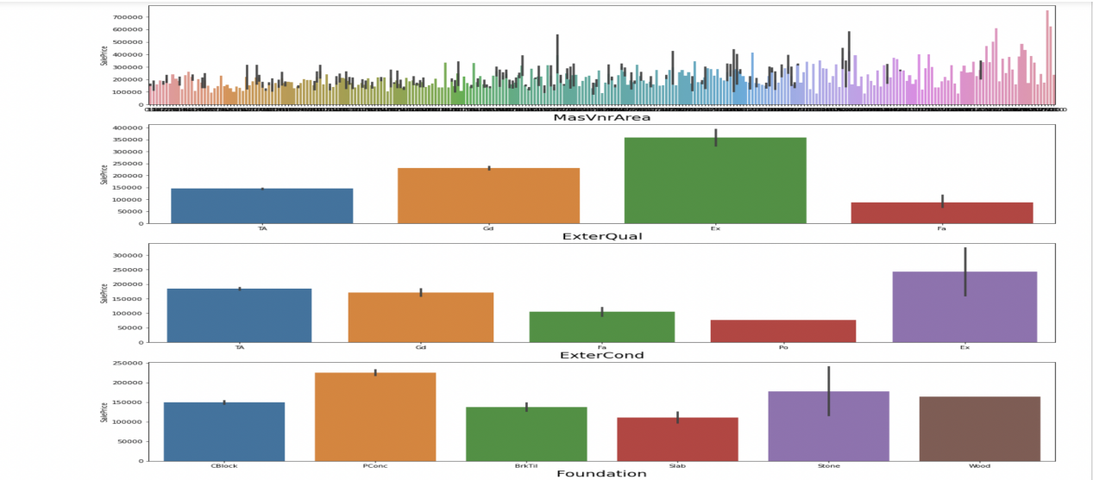
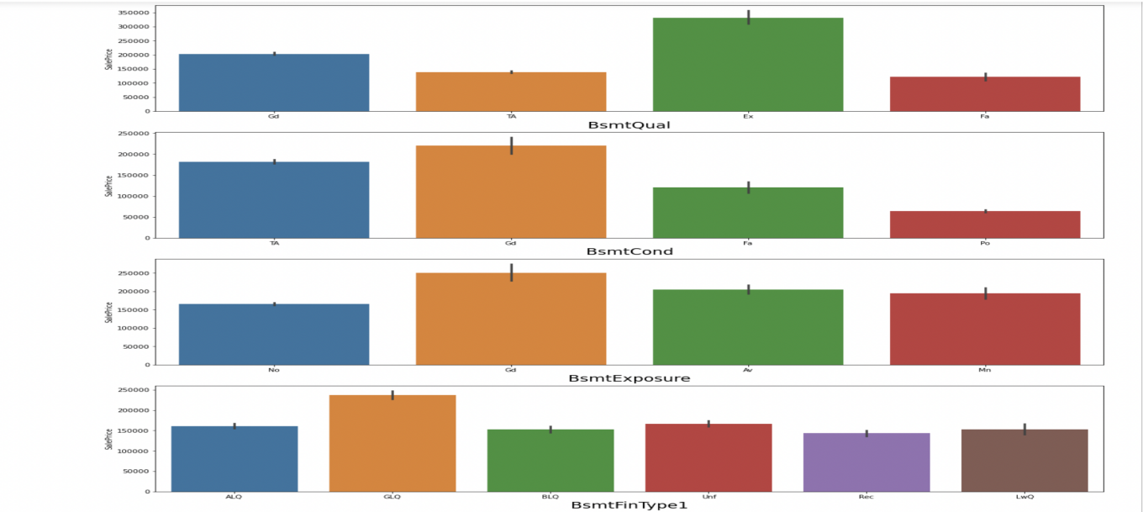
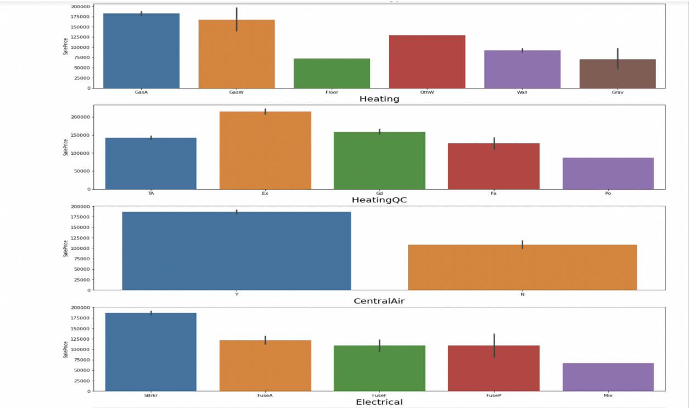
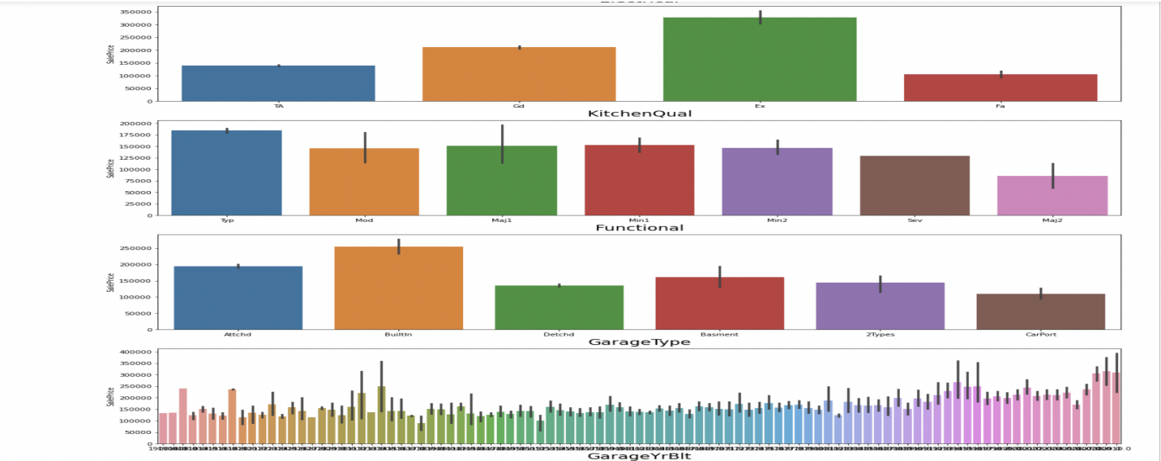
BiVariate Analysis

Slide 24
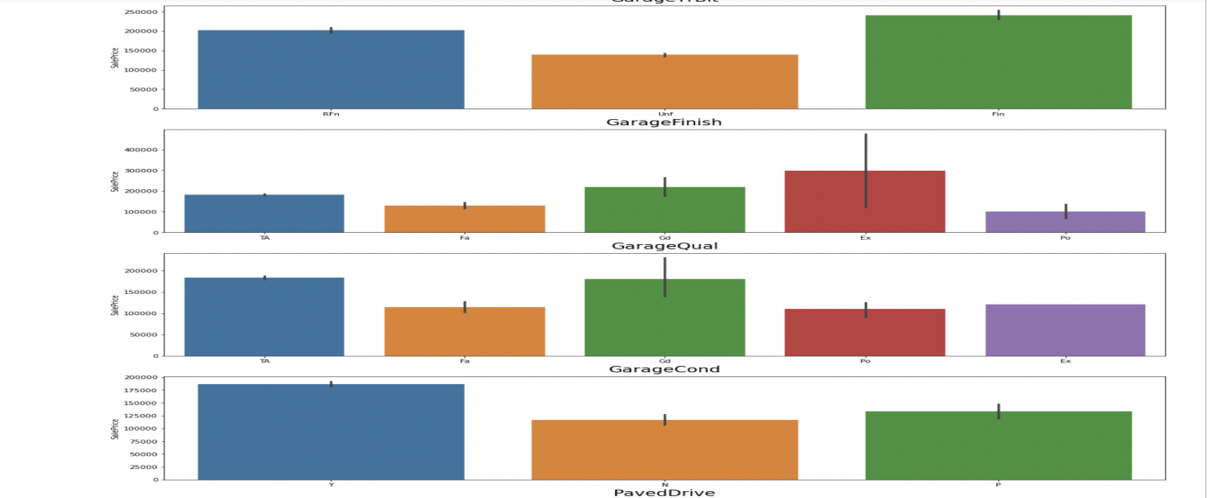
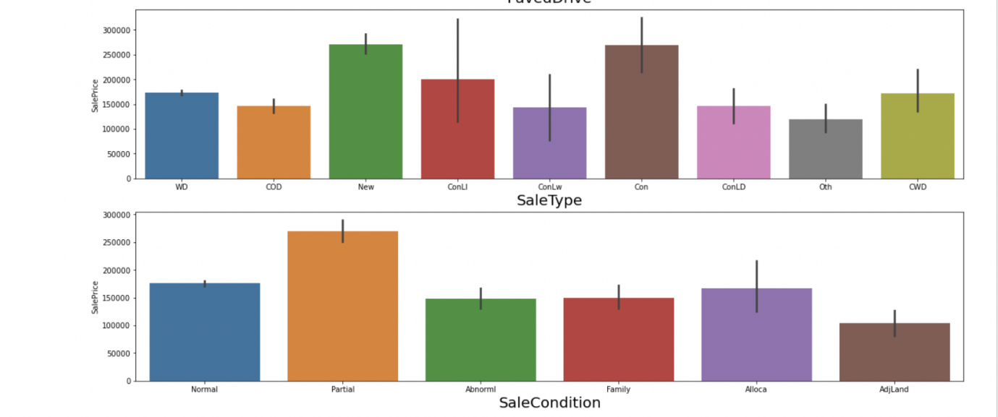
BiVariate Analysis

Slide 25
Bivariate Analysis
Observations:
In MSZoning most of the sale price is contributed by FV
Most of streetw which are contributed in high sale price is Pvae type streets
High sale price is also contributed by having the LotShape of the house as IR2 followed by IR3 and IR1
High sale price is contributed bu having LandContour as HLS followed by Low and Lvl type
LotConfig feature has high sale price when the config type is either FR3 or CulDSac
Landslope feature is contributing equally in sale price
Neighbourhood feature of saleprice is highly contributing with variable NoRidge
In Condition1 and Condition2 feature the sale price is high when the variable is POSA followed by PosN
BldgType feature with variable TwnhsE,1Fam contributing more for the saleprice
HouseStyle with 2.5Fin, 2Story are contrbuting more in house sale price
Roofstyle with Shed type followed by Hip,Flat, Mansard are contributing more for the saleprice
The house with RoofMatl WidShngl is contributing the high cost in the saleprice
Exterior1st feature with Stone,CemntBd type are contributing more for the house sale price
Exterior2nd feature with Other,ImStucc type are contributing more for the house sale price
ExterQual feature with Ex type is contributing more for the saleprice
ExterCond feature with Ex type is contributing more for the saleprice and variable Po is contributing less with saleprice
Foundation feature with Pconc is contributing more with the saleprice
BsmtQual with ex type has the high sale price
BsmtCond with Gd TYPE HAS THE high sale price
BsmtExposure with Gd type has the high sale price
BsmtFinType1 feature with GLQ has the high sale price
BsmtFinType1 feature with GLQ,ALQ has the high sale price
Heating Feature with GasA type is having teh high sale price
HeatingQC feature with Ex type is contributing more for saleprice
High sale price for houses will happen when there is central air conditioning system
KitchenQual with Ex type is contributing more for the sale price
Functional feature with Typ type is contributing more for sale price
Builtin Garage type is having high saleprice whereas Detchd type has less contribution for sale price
GarageFinish with Fin type has high contribution towards saleprice
GarageQual with Gd type has high saleprice
GarageCond with Gd type is contributing more for saleprice
Yes paved drive is contributing more for sale price
saletype with New,Con type has high saleprices
Partial condition is having high sale price

Slide 26
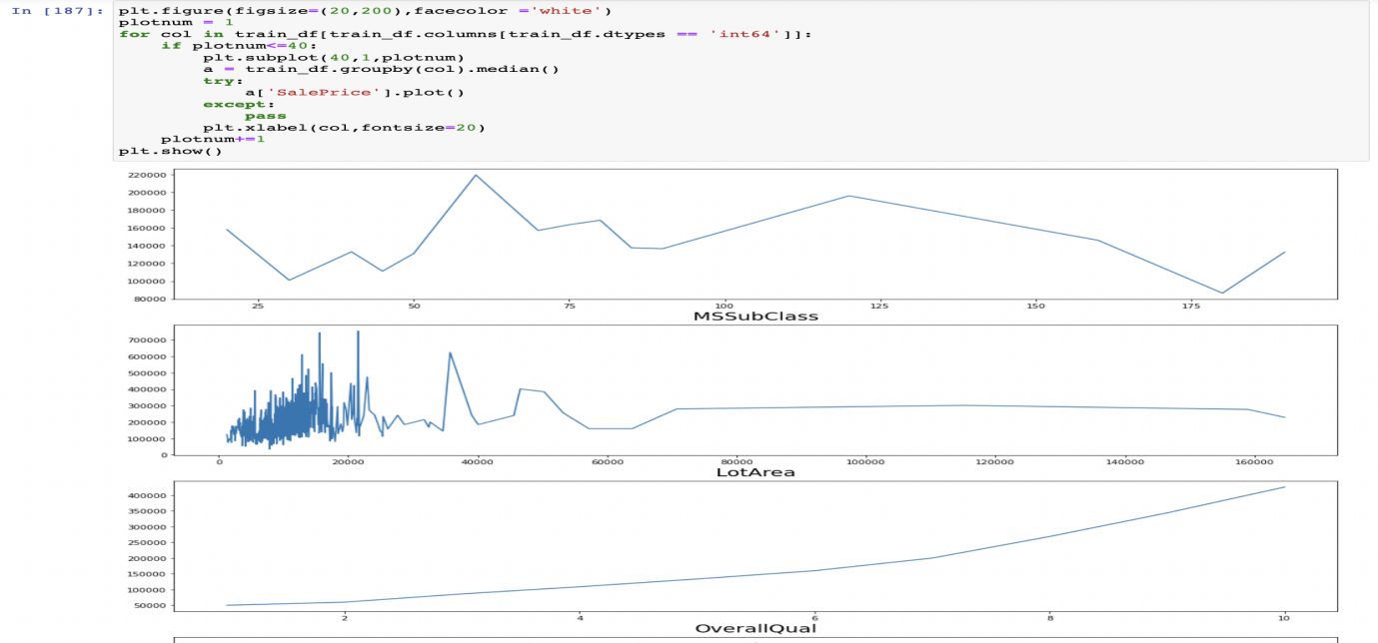
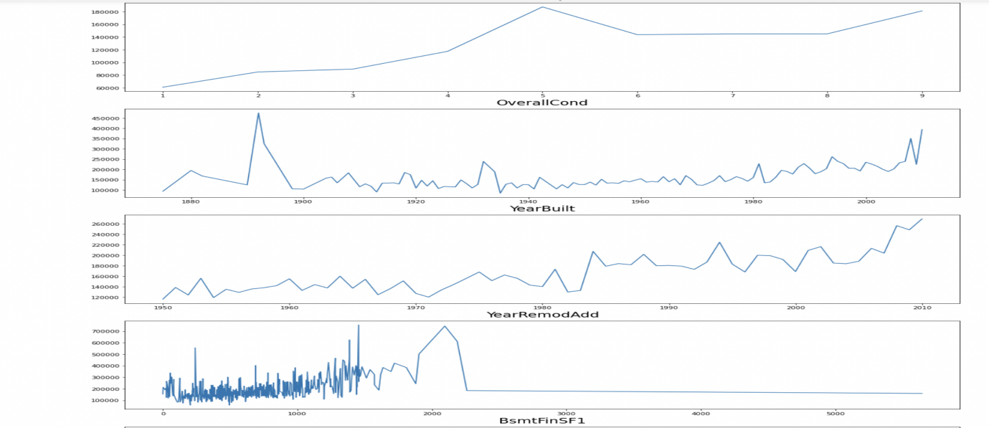
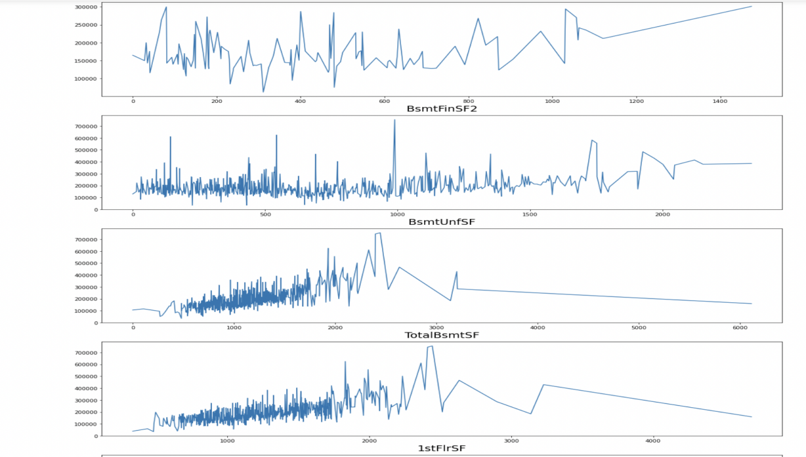
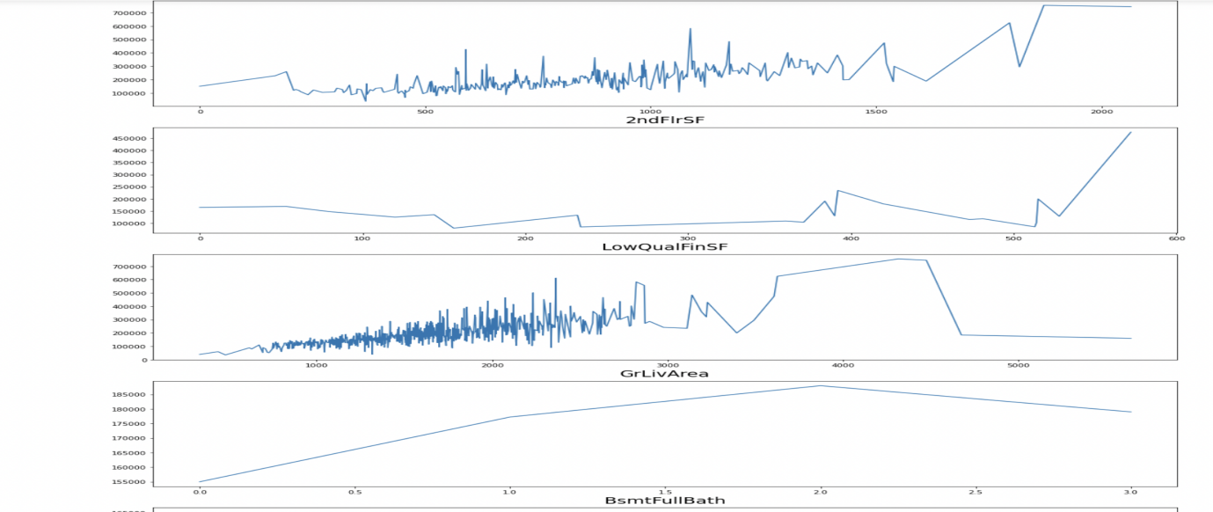
Visulization for Numerical Type Data

Slide 27
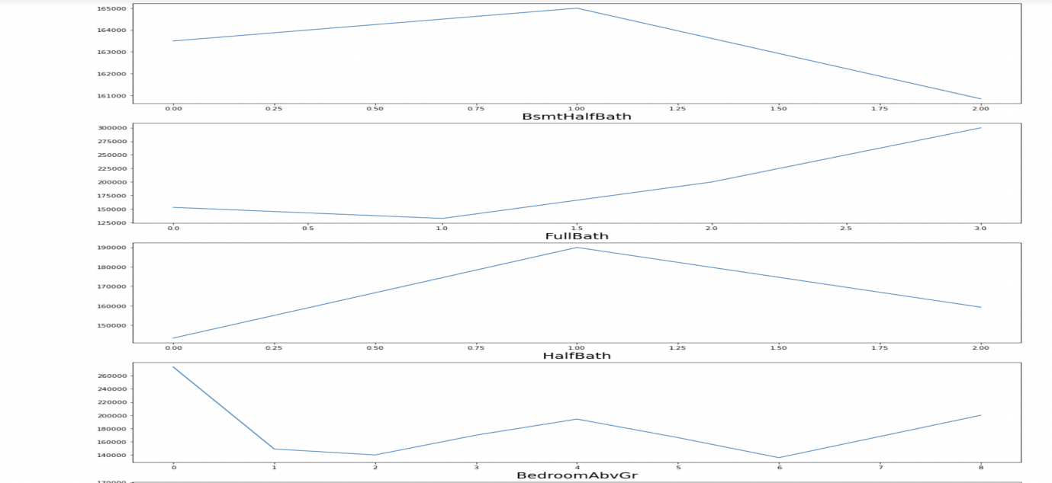
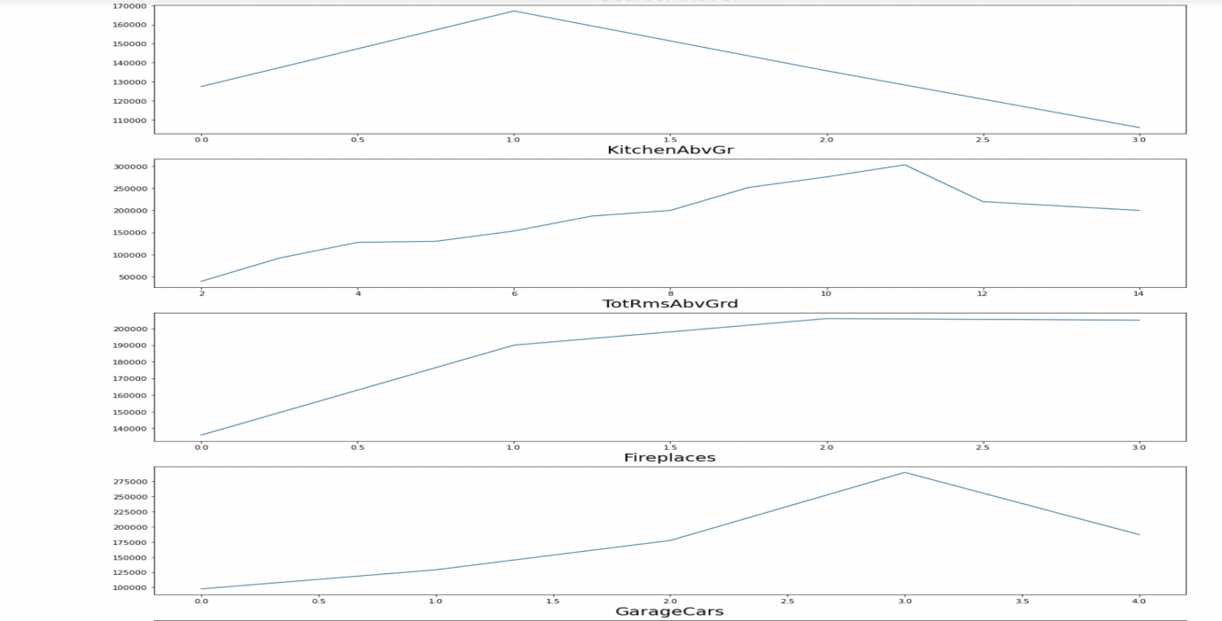
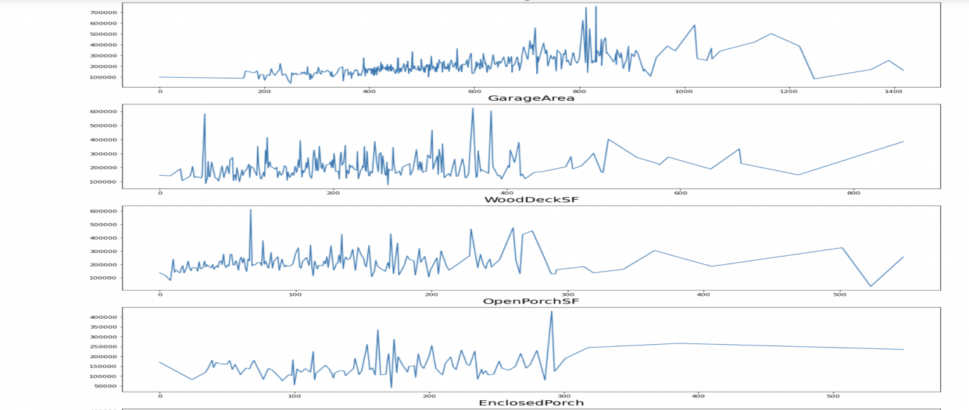
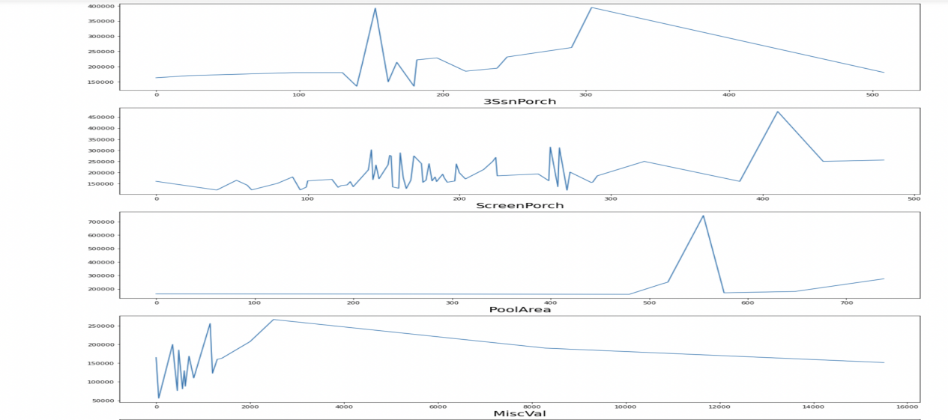
Visulization for Numerical Type Data

Slide 28
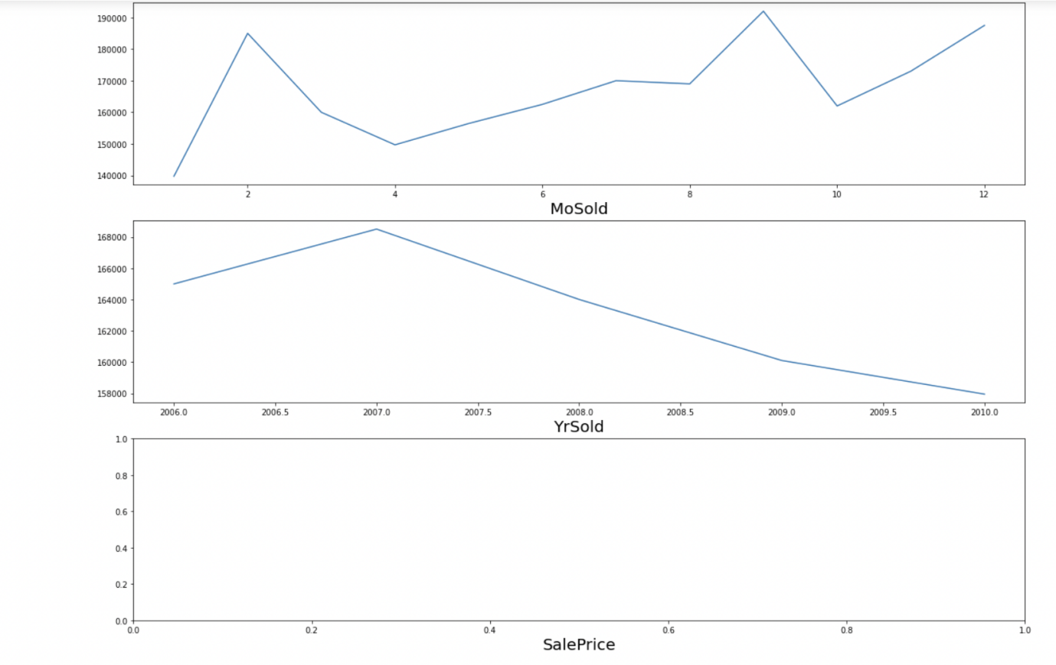
Visulization for Numerical Type Data

Slide 29
Visulization for Numerical Type Data
Observations:
1 story and 2 and 2.5 story houses built in 1946 and newer fetch the highest amount in sales.
Houses with LotFrontage between 100 ft and 200 ft are sold for the highest amount.
Houses wtih Lot area upto 25000 sqft fetch the highest amount.
There is a Linear positive relation between Overall Quality and SalesPriceo There is a Linear positive relation between Overall Condition and SalesPrice
There is a Linear positive relation between Masonry veneer area and SalesPrice
Most Sales were done for Type 1 Finished basement with area upto 2500 sqft
There is a Linear positive relation between Type 2 Finished basement area and SalesPrice
There is a Linear positive relation between Total Basement area and SalesPrice
There is a Linear positive relation between Total 1st area and 2nd floor area and SalesPrice
There is a Linear positive relation between low Quality finished square feet and SalesPrice
There is a Linear positive relation between Above grade living area square feet and SalesPrice
There is a Linear negative relation between basment half bath and SalesPrice
There is a Linear positive relation between Full Bathroom and SalesPrice
There is a Linear positive relation between Total rooms above grade and SalesPrice
There is a Linear positive relation between Fireplaces and SalesPrice
There is a Linear positive relation between Garage Car capacity and SalesPrice
There is a Linear positive relation between Garage area and SalesPrice
Sales Prices peaked between 0-400 square feet area for Wooden Deck
Sales Prices peaked between 0-300 square feet area for Open Porch
Sales Price and Enclosed Porch area have a positive relation
Sales Price and 3 season Porch area have a positive relation
Sales Price and screen Porch area have a positive relation
Sales Price and Month Sold have a positive relation
Sales Price and Month Sold have a positive relation
Sales Price and house age have a negative relationo Sales Price and remodelling age have a negative relation
Sales Price and Garage age have a negative relation.

Slide 30
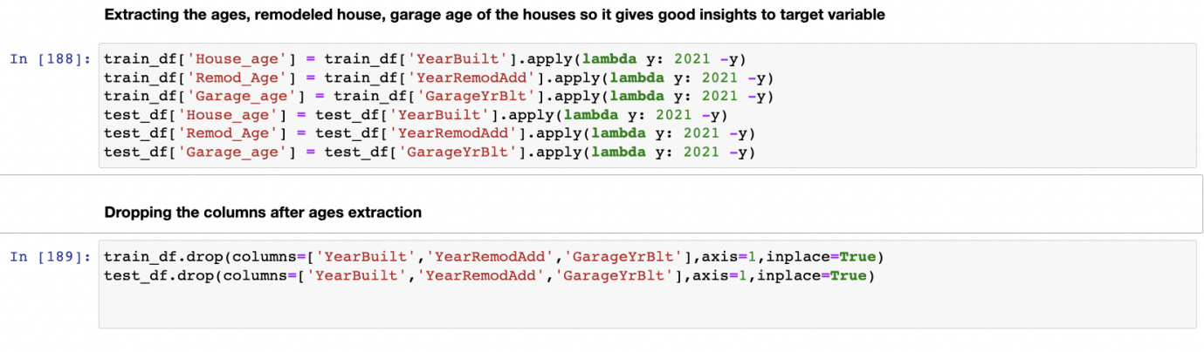
Handling Date time format data masked with string type

Slide 31
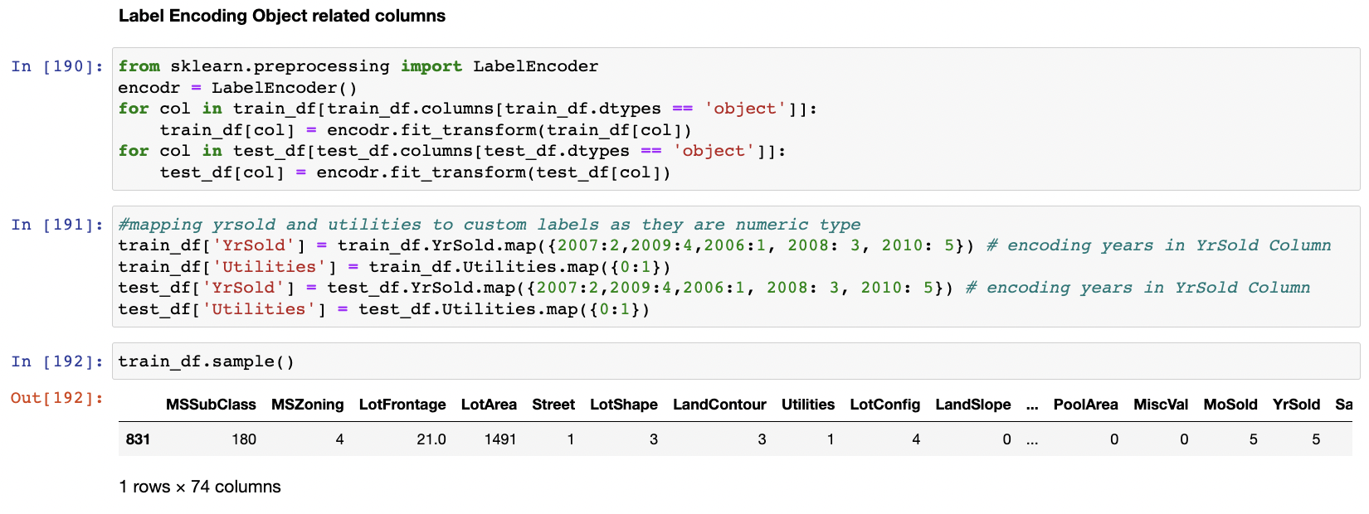
Label Encoding Categorical Type Data

Slide 32
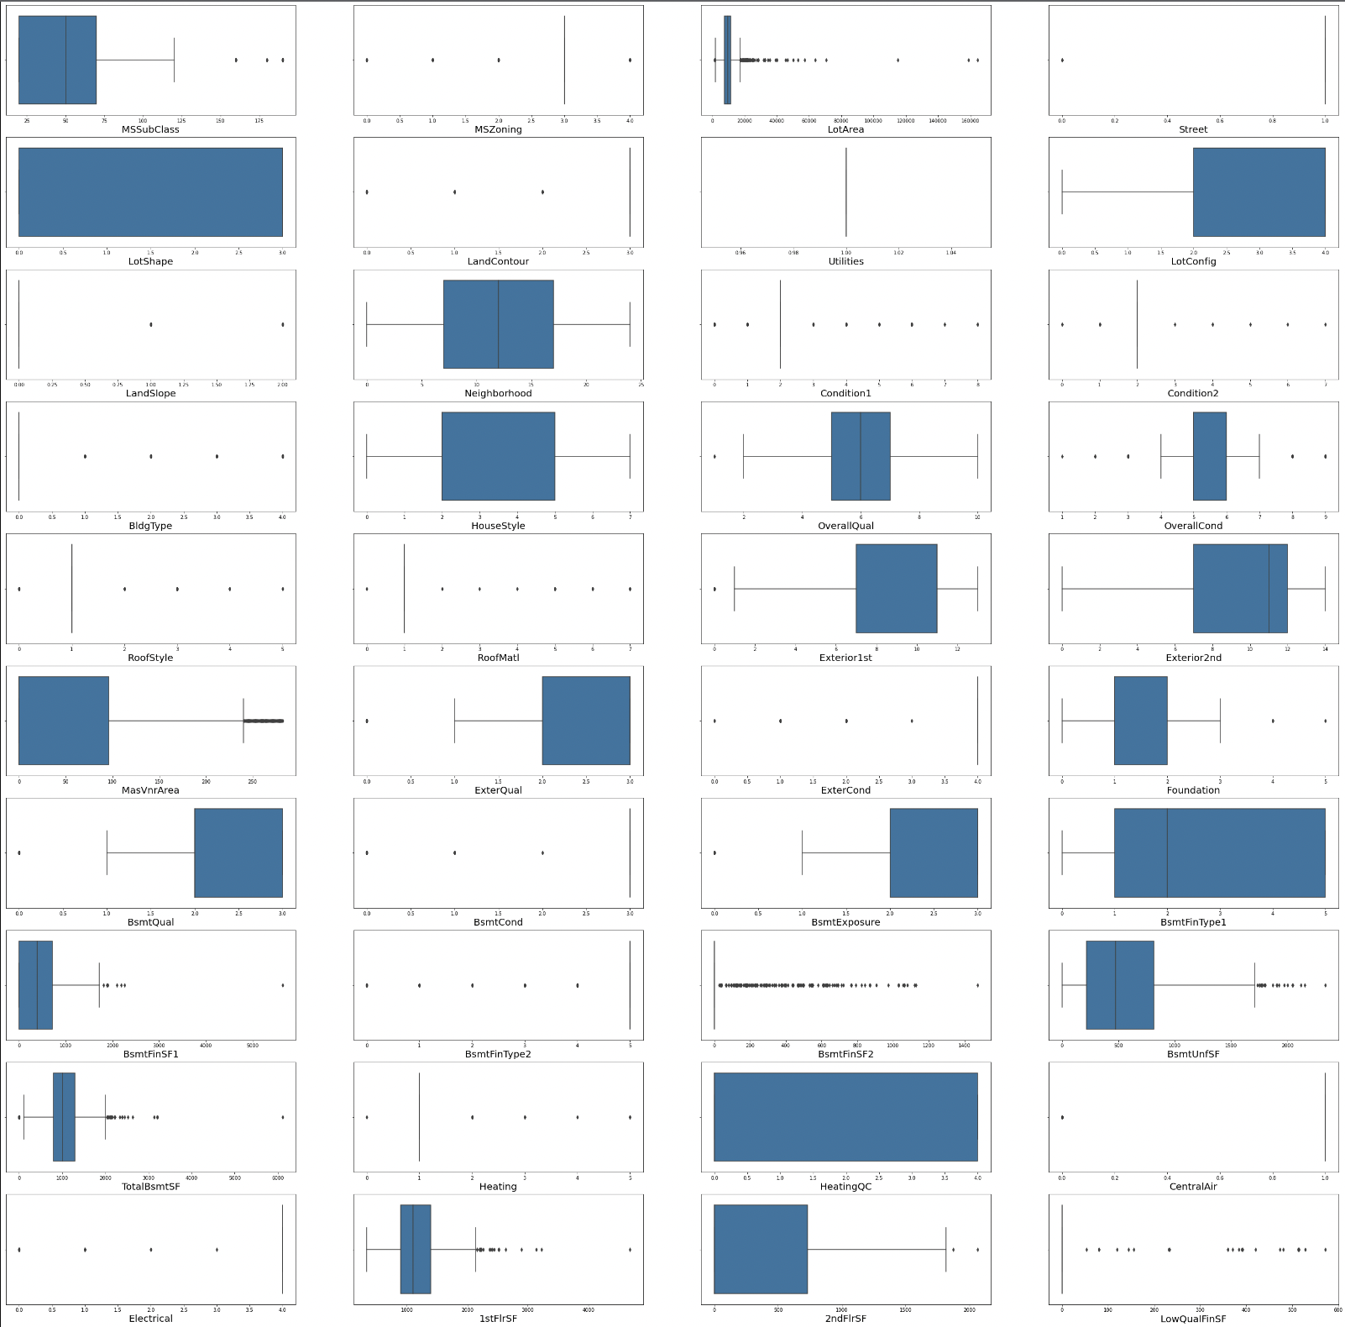
Checking for outliers in the dataset

Slide 33
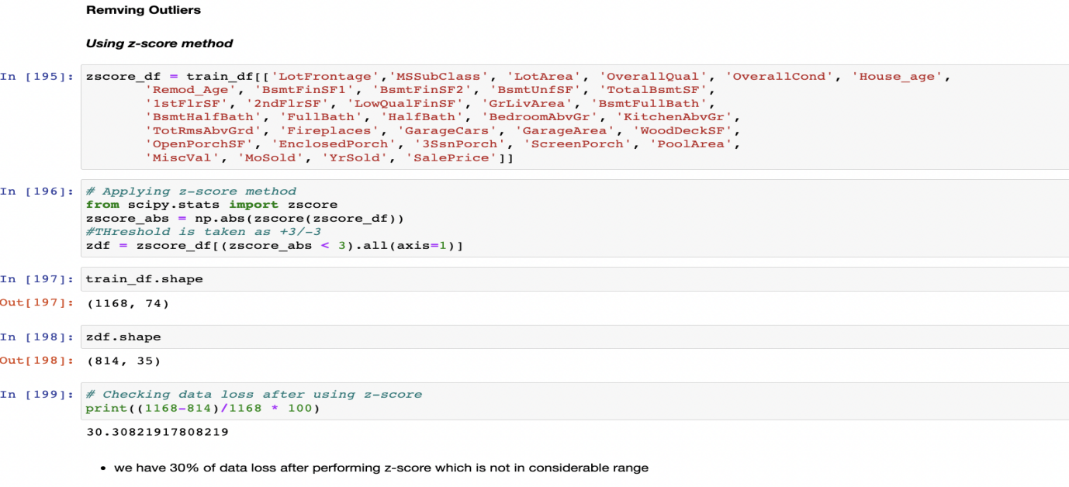
Check the Amount of outliers present in Dataset Using Z-score method
After Removing the outliers using z-score we have data loss of 30% which is not in considerable range

Slide 34
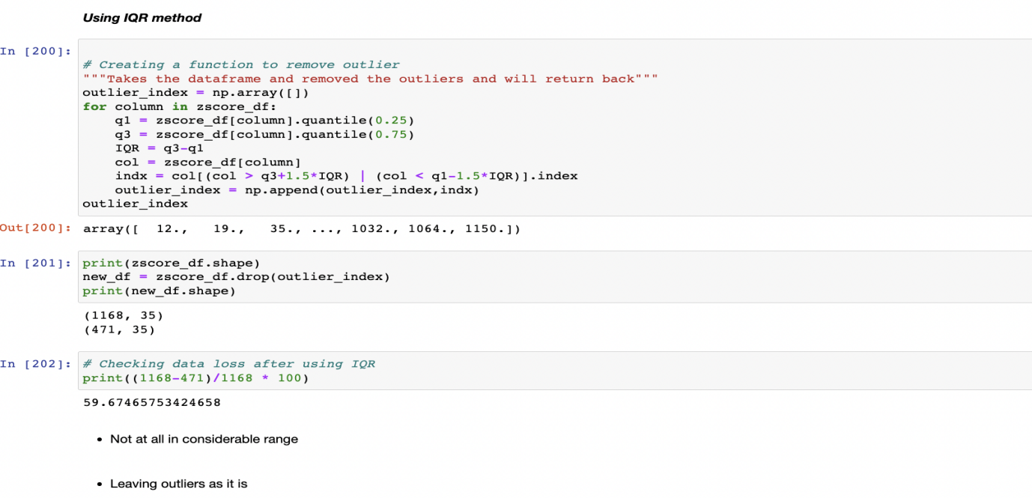
Check the Amount of outliers present in Dataset Using IQR method
After Removing the outliers using IQR we have data loss of 59% which is not in considerable range

Slide 35
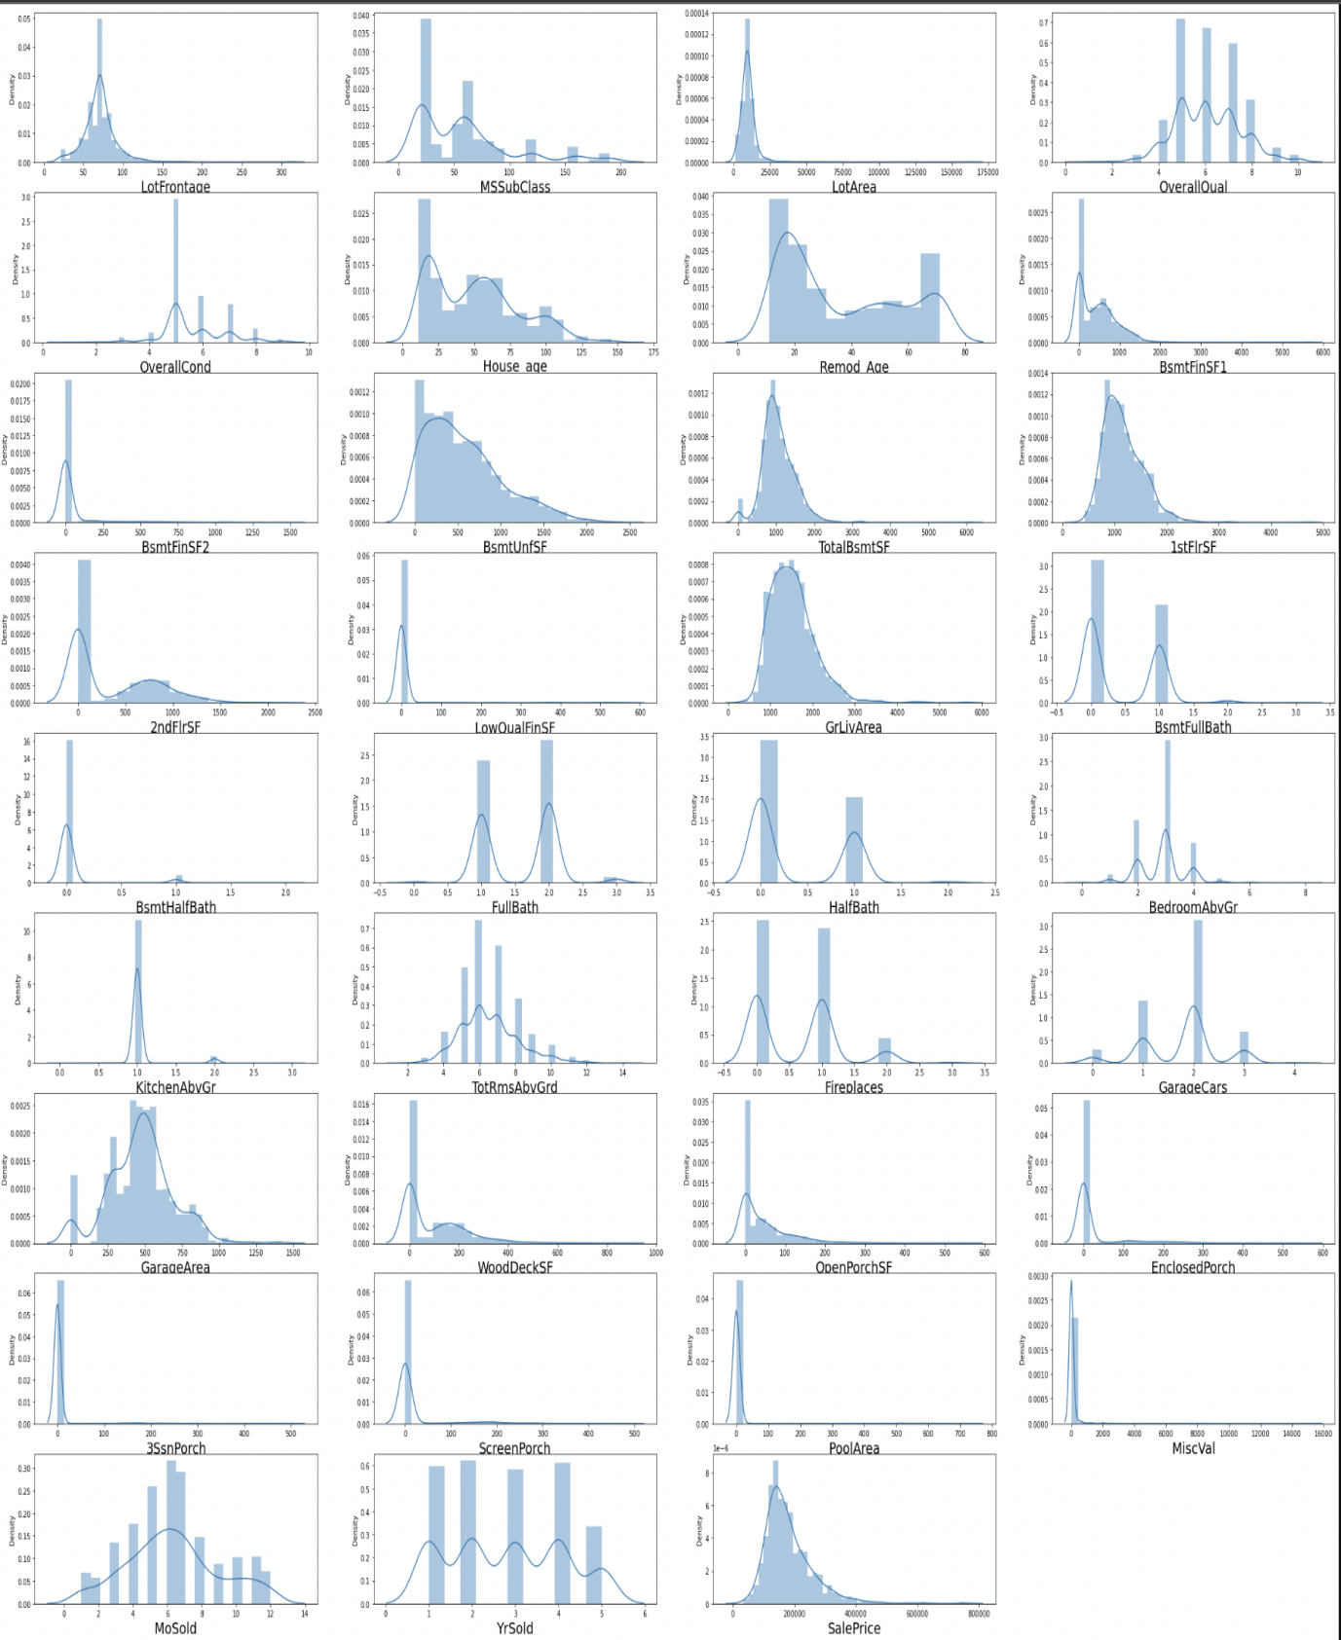
Checking for skewness in dataset
Lot of the data are right skewed in the dataframe Some of the columns are multinodal.

Slide 36
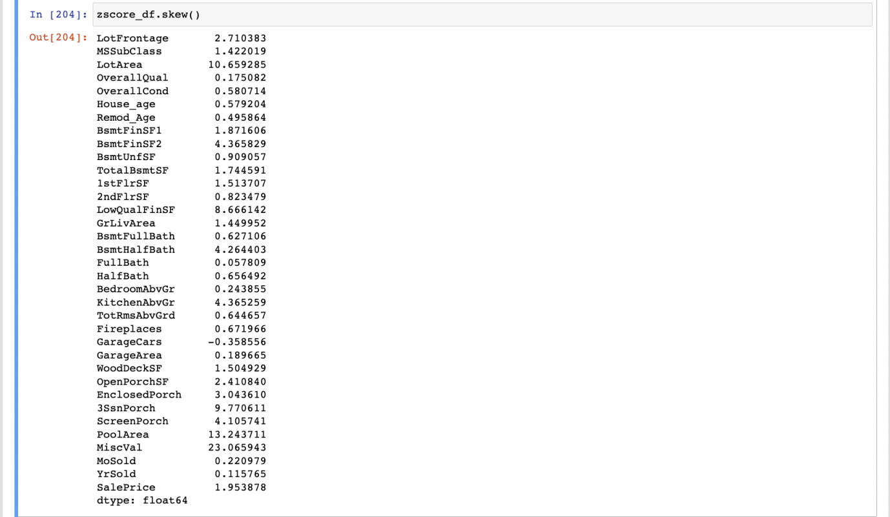
Checking for skewness in dataset

Slide 37
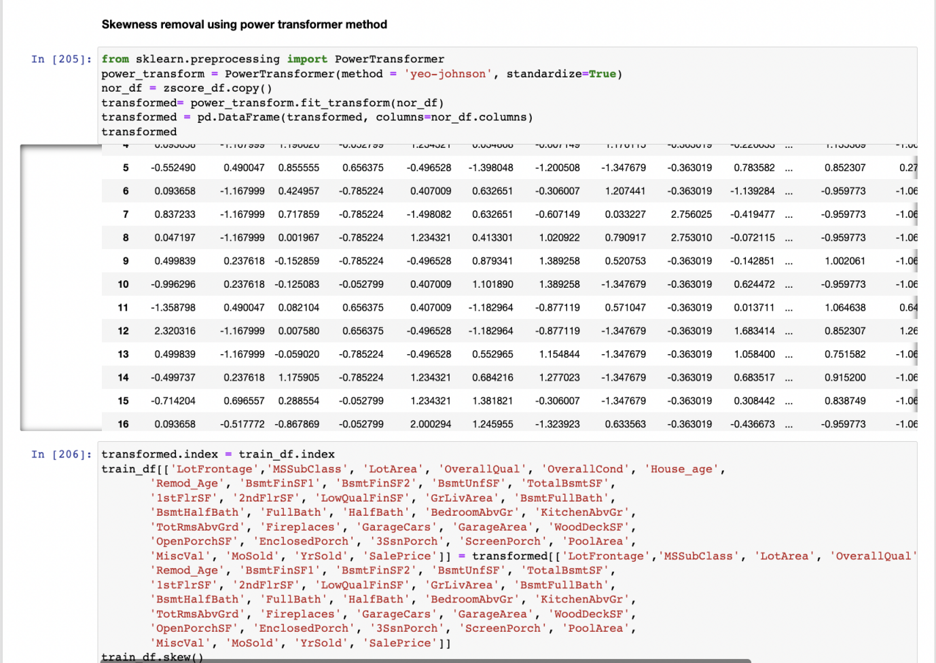
Handling skewness using PowerTransformer

Slide 38
Handling skewness using PowerTransformer
Electrical -3.104209
1stFlrSF -0.002391
2ndFlrSF 0.280208
LowQualFinSF 6.922843
GrLivArea -0.000054
BsmtFullBath 0.365488
BsmtHalfBath 3.954345
FullBath -0.045944
HalfBath 0.498003
BedroomAbvGr 0.116498
KitchenAbvGr -2.370593
KitchenQual -1.408106
TotRmsAbvGrd 0.002332
Functional -3.999663
Fireplaces 0.084950
GarageType 0.831142
GarageFinish -0.450190
GarageCars -0.022970
GarageArea -0.320370
GarageQual -4.582386
GarageCond -5.422472
PavedDrive -3.274035
WoodDeckSF 0.113026
OpenPorchSF -0.002749
EnclosedPorch 2.022616
3SsnPorch 7.087955
ScreenPorch 3.067153
PoolArea 12.817372
MiscVal 4.991071
MoSold -0.035838
YrSold -0.083577
SaleType -3.660513
SaleCondition -2.671829
SalePrice -0.006010
House_age -0.063679
Remod_Age 0.039294
Garage_age 0.708074
MSSubClass 0.064007
MSZoning -1.796785
LotFrontage 0.161368
LotArea 0.032509
Street -17.021969
LotShape -0.603775
LandContour -3.125982
Utilities 0.000000
LotConfig -1.118821
LandSlope 4.812568
Neighborhood 0.043735
Condition1 3.008289
Condition2 11.514458
BldgType 2.318657
HouseStyle 0.285680
OverallQual 0.021658
OverallCond 0.048063
RoofStyle 1.498560
RoofMatl 7.577352
Exterior1st -0.612816
Exterior2nd -0.592349
MasVnrArea 1.355502
ExterQual -1.810843
ExterCond -2.516219
Foundation -0.002761
BsmtQual -1.343781
BsmtCond -3.293554
BsmtExposure -1.166987
BsmtFinType1 -0.068901
BsmtFinSF1 -0.404528
BsmtFinType2 -3.615783
BsmtFinSF2 2.394737
BsmtUnfSF -0.284390
TotalBsmtSF 0.286779
Heating 10.103609
HeatingQC 0.449933
CentralAir -3.475188

Slide 39
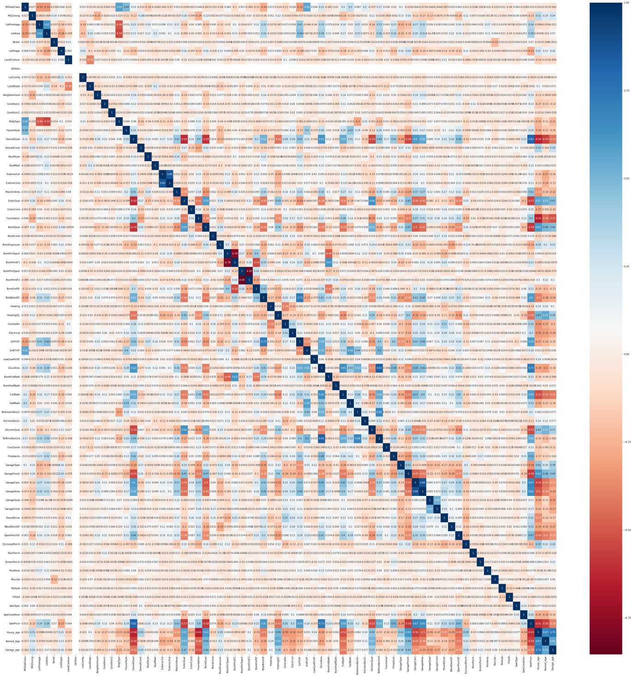
Correlation of the train data

Slide 40
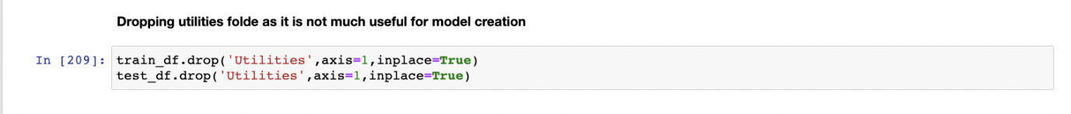
Correlation of the train data
Max Number of features are positively correlated with SalePrice
Yearbuild is negatively correlated with EnclosedPorch
BsmtUnfsF is negatively correlated with BsmtFullBath
ExternalQual,BsmtQual,KitchenQual, GarageFinish is negatively correlated with saleprice
Dropping Utilities feature as it is not showing scope on sale price

Slide 41
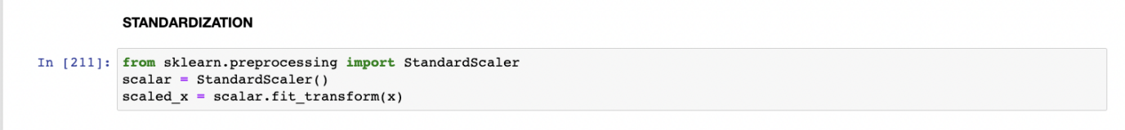
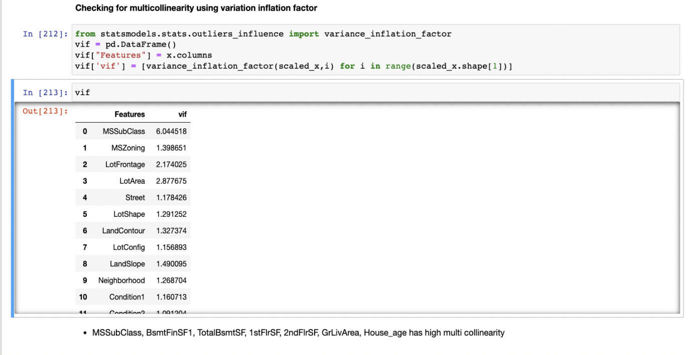
Standardization and multicollinearity
●
Standardization
Multi-collinearity
MSSubClass, BsmtFinSF1, TotalBsmtSF, 1stFlrSF, 2ndFlrSF,
GrLivArea, House_age has high multi collinearity.

Slide 42
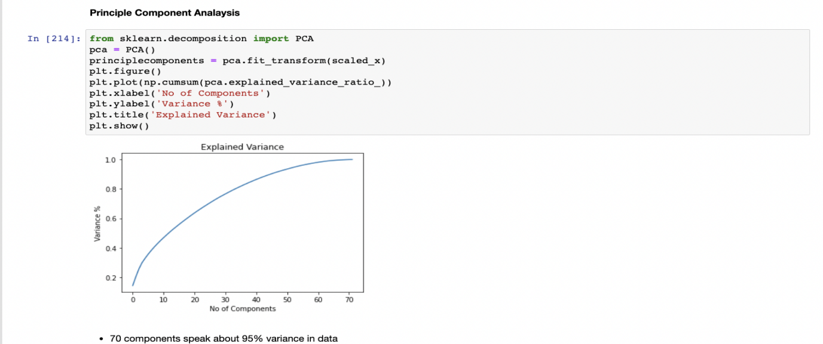
Principle Component Analysis
●
70 components speak about 95% variance in data.

Slide 43
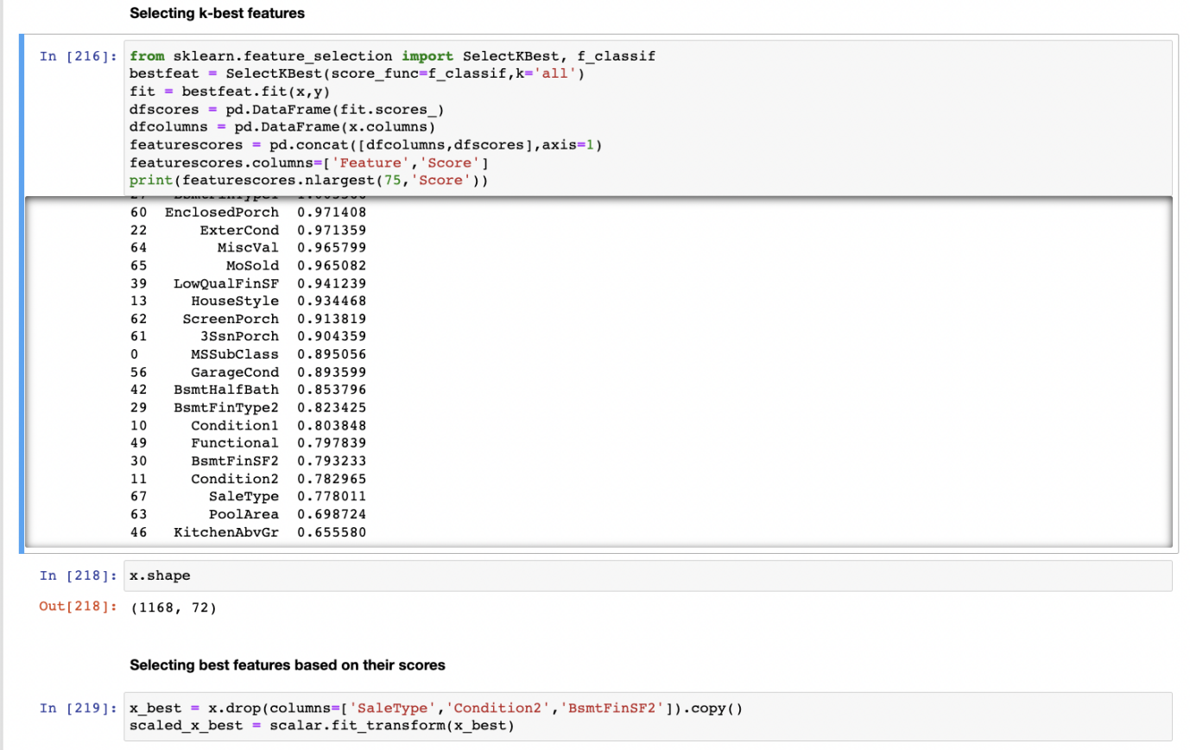
Selecting K-best Features and dropping un-useful columns
●

Slide 44
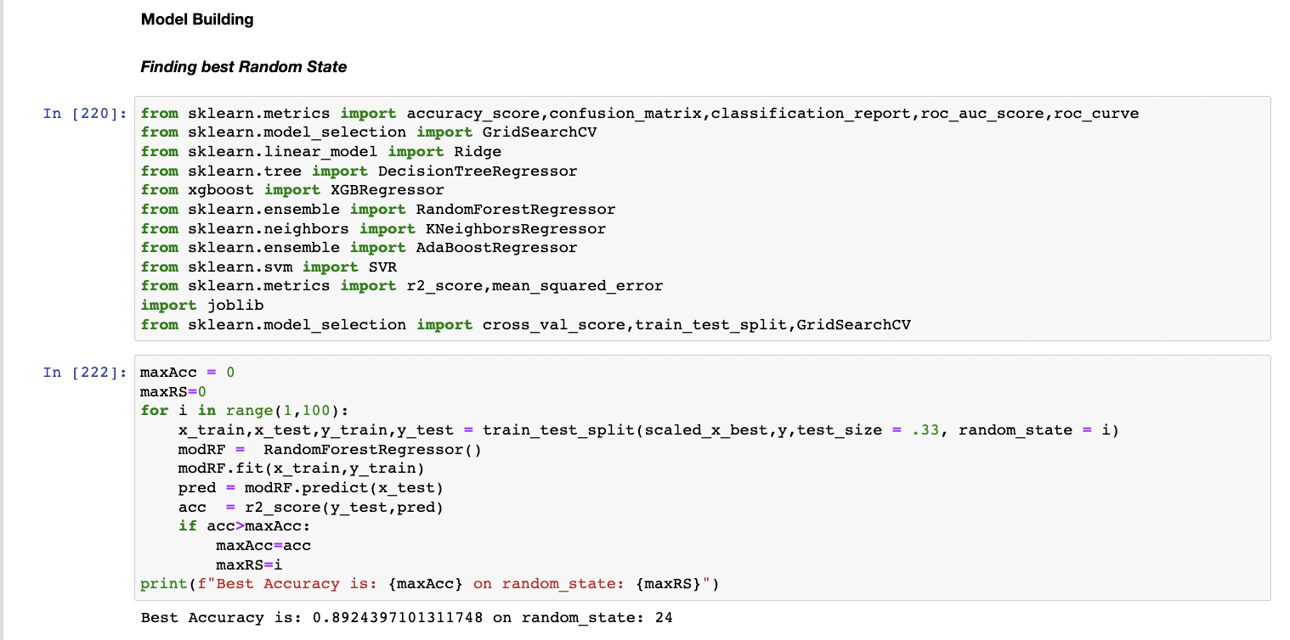
Importing Model Libraries and Finding Random state
●
Best Accuracy is: 0.8924397101311748 on random_state: 24

Slide 45
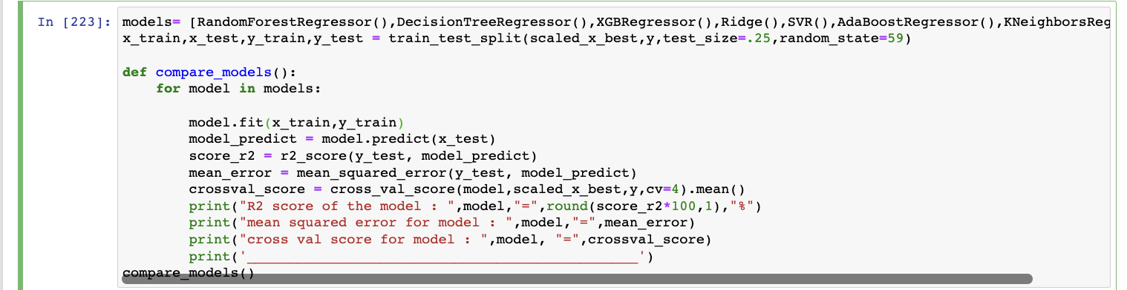
Training Data with Different Model Libraries
●

Slide 46
Results for Model Training
R2 score of the model : RandomForestRegressor() = 87.1 % mean squared error for model : RandomForestRegressor() = 0.12404986872351596 cross val score for model : RandomForestRegressor() = 0.8543177964627404 _______________________________________________ R2 score of the model : DecisionTreeRegressor() = 71.2 % mean squared error for model : DecisionTreeRegressor() = 0.27647808913929195 cross val score for model : DecisionTreeRegressor() = 0.7029503817522236 _______________________________________________ R2 score of the model : XGBRegressor(base_score=0.5, booster='gbtree', callbacks=None, colsample_bylevel=1, colsample_bynode=1, colsample_bytree=1, early_stopping_rounds=None, enable_categorical=False, eval_metric=None, gamma=0, gpu_id=-1, grow_policy='depthwise', importance_type=None, interaction_constraints='', learning_rate=0.300000012, max_bin=256, max_cat_to_onehot=4, max_delta_step=0, max_depth=6, max_leaves=0, min_child_weight=1, missing=nan, monotone_constraints='()', n_estimators=100, n_jobs=0, num_parallel_tree=1, predictor='auto', random_state=0, reg_alpha=0, reg_lambda=1, ...) = 87.5 % mean squared error for model : XGBRegressor(base_score=0.5, booster='gbtree', callbacks=None, colsample_bylevel=1, colsample_bynode=1, colsample_bytree=1, early_stopping_rounds=None, enable_categorical=False, eval_metric=None, gamma=0, gpu_id=-1, grow_policy='depthwise', importance_type=None, interaction_constraints='', learning_rate=0.300000012, max_bin=256, max_cat_to_onehot=4, max_delta_step=0, max_depth=6, max_leaves=0, min_child_weight=1, missing=nan, monotone_constraints='()', n_estimators=100, n_jobs=0, num_parallel_tree=1, predictor='auto', random_state=0, reg_alpha=0, reg_lambda=1, ...) = 0.12040357496536425 cross val score for model : XGBRegressor(base_score=0.5, booster='gbtree', callbacks=None, colsample_bylevel=1, colsample_bynode=1, colsample_bytree=1, early_stopping_rounds=None, enable_categorical=False, eval_metric=None, gamma=0, gpu_id=-1, grow_policy='depthwise', importance_type=None, interaction_constraints='', learning_rate=0.300000012, max_bin=256, max_cat_to_onehot=4, max_delta_step=0, max_depth=6, max_leaves=0, min_child_weight=1, missing=nan, monotone_constraints='()', n_estimators=100, n_jobs=0, num_parallel_tree=1, predictor='auto', random_state=0, reg_alpha=0, reg_lambda=1, ...) = 0.8526377678389339
●

Slide 47
Results for Model Training
●
R2 score of the model : Ridge() = 82.3 %
mean squared error for model : Ridge() = 0.16960554508358183
cross val score for model : Ridge() = 0.8549982920253969
_______________________________________________
R2 score of the model : SVR() = 82.1 %
mean squared error for model : SVR() = 0.17225632516358153
cross val score for model : SVR() = 0.8024883218752944
_______________________________________________
R2 score of the model : AdaBoostRegressor() = 80.4 %
mean squared error for model : AdaBoostRegressor() = 0.1881442455910854
cross val score for model : AdaBoostRegressor() = 0.7988978681272337
_______________________________________________
R2 score of the model : KNeighborsRegressor() = 78.3 %
mean squared error for model : KNeighborsRegressor() = 0.20842969143319431
cross val score for model : KNeighborsRegressor() = 0.7651416544528145
_______________________________________________
Random Forest Regression is giving good accuracy results comparing with other models

Slide 48
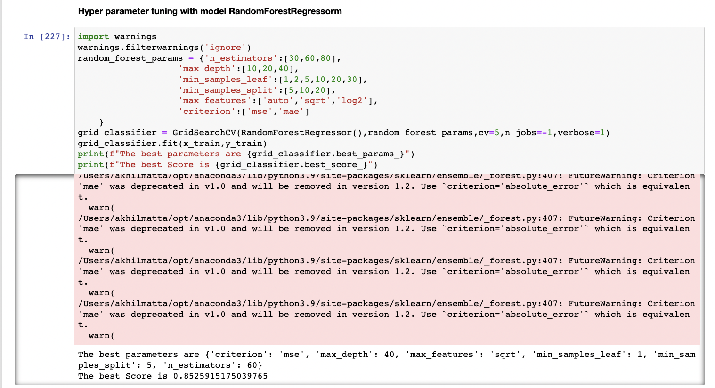
Hyper parameter tuning for Random forest regressor
●
The best parameters are { 'criterion': 'mse', 'max_depth': 40, 'max_features': 'sqrt', 'min_samples_leaf': 1, 'min_samples_split': 5, 'n_estimators': 60} The best Score is 0.8525915175039765

Slide 49
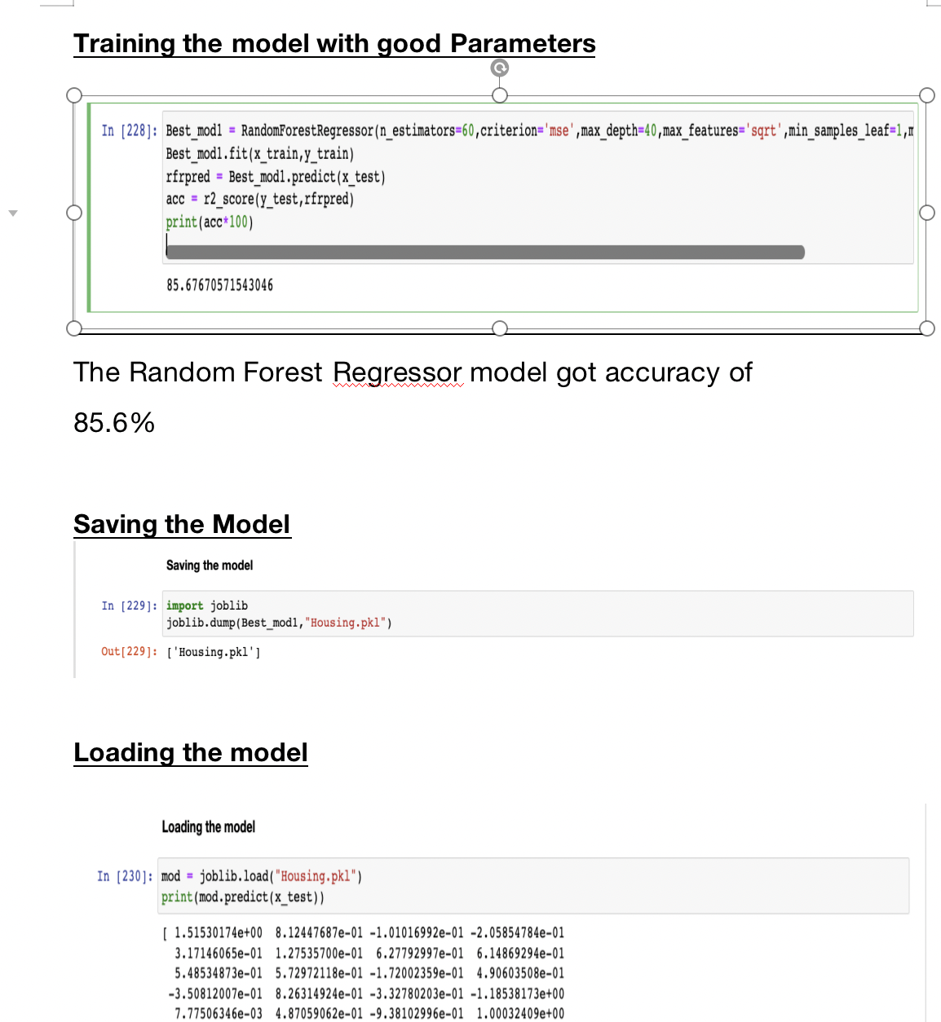
Training the model with best params,saving and Loading models
●

Slide 50
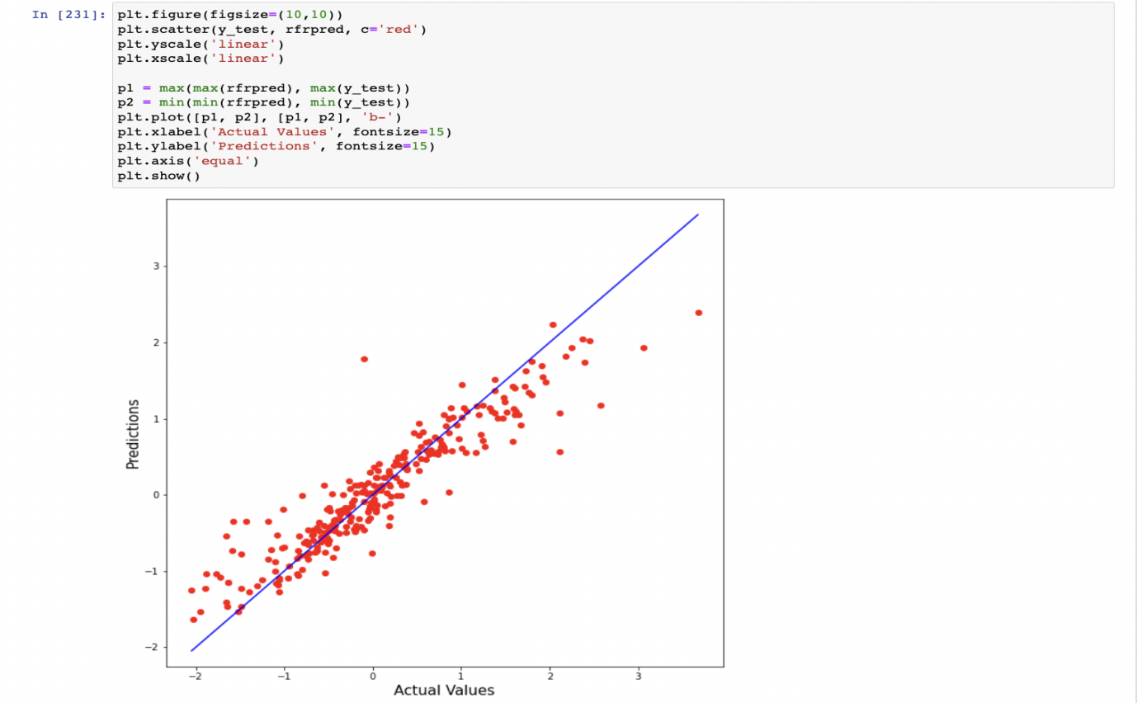
Visualising Predicted and actual values
●

Slide 51
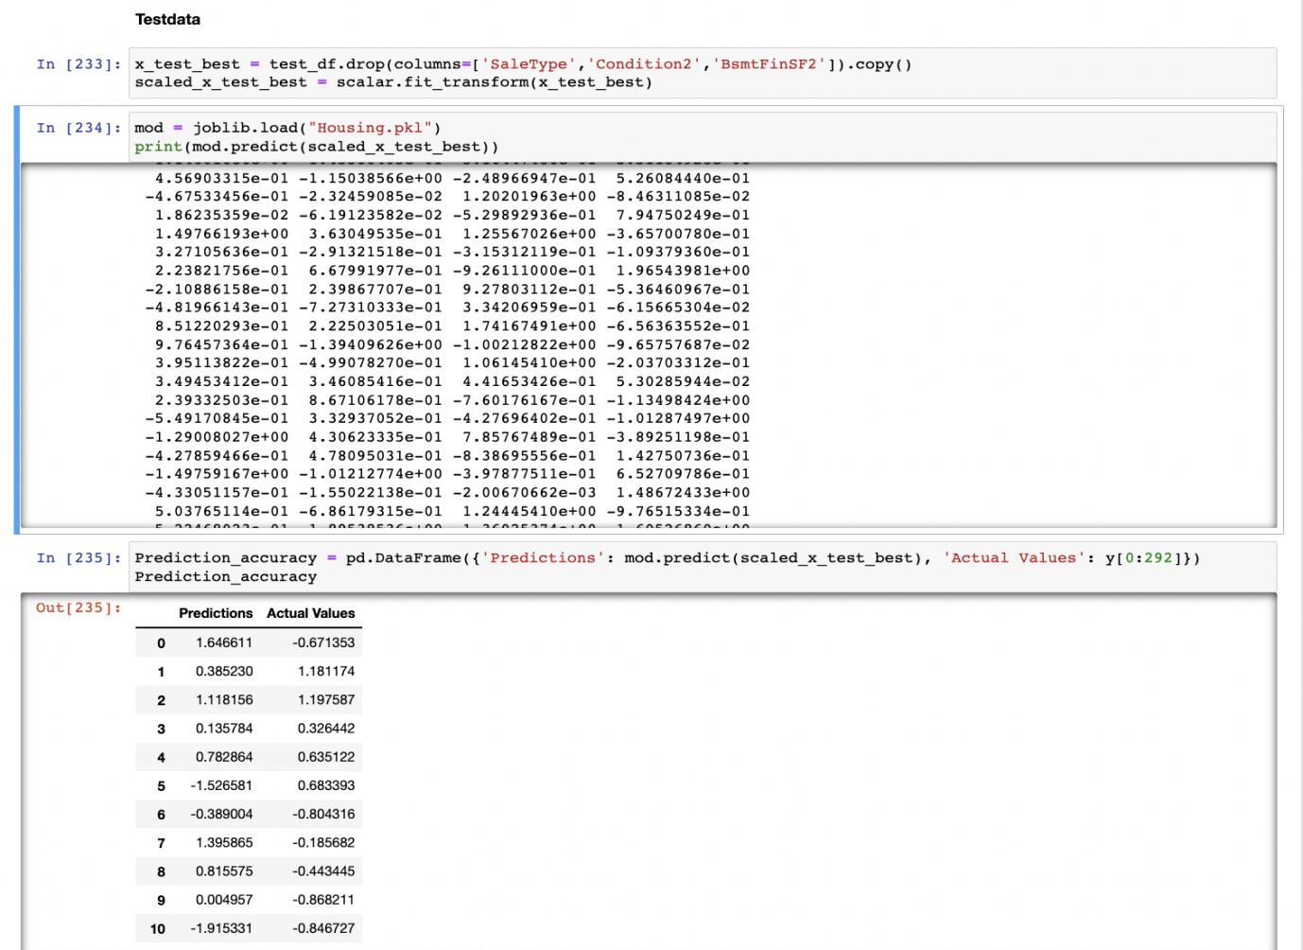
Actual values and predicted Values
●

Slide 52
Thanks
for your Attention
Add your words here

